Slide 1


NLC QUALIFIED PRODUCTS LIST
How to Update Your QPL Listing
Under NLC V5.2
Applications Webinar
September 17, 2026
A step-by-step walkthrough for NLC manufacturers
designlights.org
Notes:
Welcome and thank you for joining. Today’s session is a practical, step-by-step walkthrough of how to submit an NLC V5.2 application to update your Qualified Products List listing.
This webinar is designed for NLC manufacturers - both those integrating thermostats and those pursuing ANSI C137.9 configuration reporting. Our goal is to give you the clarity you need for a smooth, efficient qualification, and to flag the common mistakes that cause review delays before you run into them.
Quick housekeeping: we’ll take questions at the end, and we’ll share a resources slide with links to everything referenced today. Let’s get started.

Slide 2
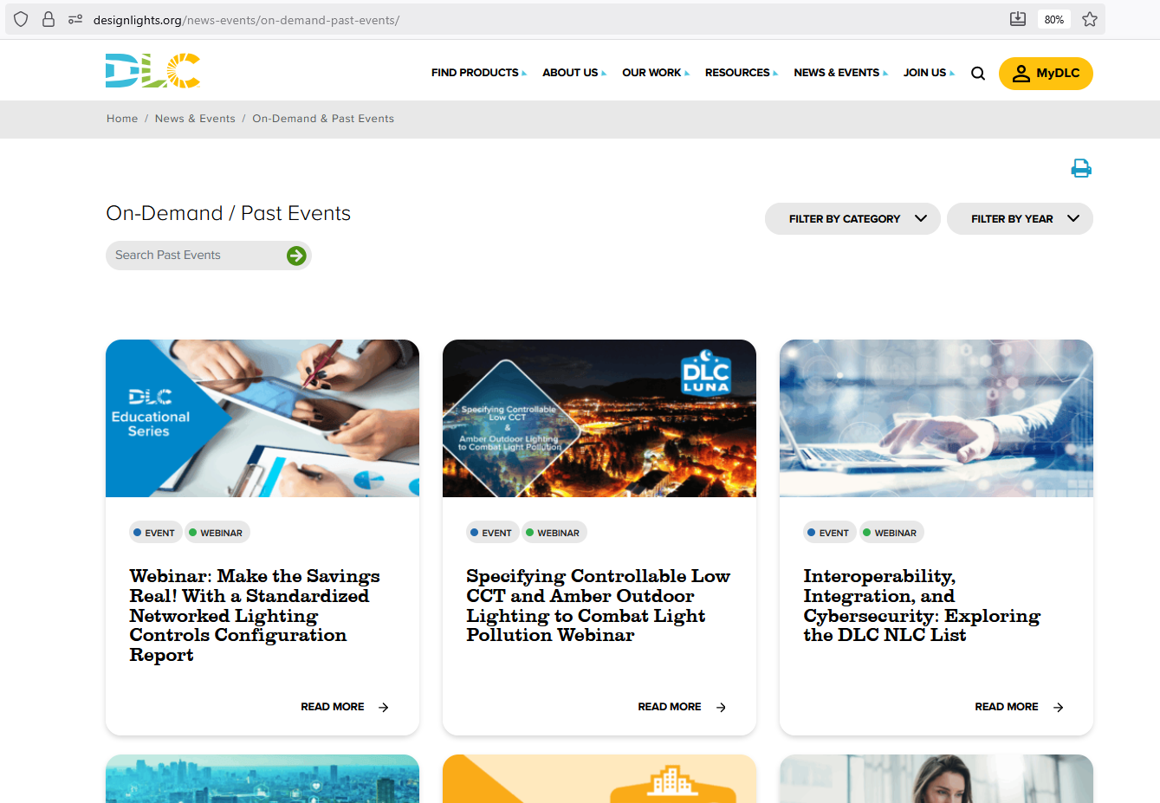
Slides and recorded webinar will be posted on the DLC News & Events page at https://designlights.org shortly after today’s presentation
All attendees are automatically muted
Notes:
Before we get started, I’ll take care of a little housekeeping. If there’s something you’d like to go back and see again or you’d like to share this webinar with someone who couldn’t attend, the slides and recording will be posted on our website.
I should also let you know that all attendees have been automatically muted, and we’ll keep it this way for the entire webinar. (click)

Slide 3


Webinar Orientation
Questions will be held until the end during a live Q&A
  Use the Question pane (not Chat) to submit for Q&A
Notes:
But of course we still want you to be able to communicate. If you have any questions, you can use the question pane. You can locate this at the top right by clicking on the speech bubble with the question mark. The question pane is distinct from the chat pane, which has the two layered speech bubbles. We will not be using the chat pane during this call. So be sure to use the question pane only.
We’ll be answering some questions through text throughout the webinar, but we won’t pause the presentation to answer. However, near the end of the webinar we will hold a live Q&A session. We will choose some of the more common questions to answer live, so keep them coming throughout the call so we know what is most relevant to you. (click)

Slide 4

The DesignLights Consortium is an independent, nonprofit organization providing decision makers with data and resources on quality lighting, controls, and integrated building systems to reduce energy, carbon, and light pollution.
Notes:
For those of you who may joining us for the first time, I should mention that the DLC is a nonprofit organization with a mission to reduce energy, carbon, and light pollution. We do this by delivering the right information to decision makers, and one of the main ways we do that is by creating technical requirements that underpin our qualified product lists which support the majority of incentive programs across North America. (click)

Slide 5



Presenters
Bagwat Mohan
Senior Technical Operations Manager
Levin Nock
Senior Technical Manager
Andrew Antares
Project Manger

Slide 6



WEBINAR OBJECTIVES
What You Will Learn
Submit a compliant V5.2 application
Master the documentation
A clear, step-by-step process to update your QPL listing under the new V5.2 requirements -- from portal login to final submission.
Understand exactly what to attach and cite for every question, and how to avoid the review delays that hold up qualification.
WE’LL COVER
1
V5.2 Overview
2
Preparation
3
Submission Walkthrough
4
Documentation (OEM & Pvt Label)
5
Mistakes to Avoid
5
Notes:
There are two things we want you to walk away able to do.
First, run the full submission process yourself - a clear set of steps to update your QPL listing under V5.2, start to finish.
Second, get the documentation right the first time. Documentation issues are the number-one cause of review delays, so we’ll spend real time on what to attach and which party provides each document.
The bar at the bottom is our roadmap: we start with a V5.2 overview, move into preparation, walk the submission step by step, dig into the documentation for thermostats and configuration report, and close with the common mistakes to avoid.

Slide 7



THE UPDATE
What Is NLC V5.2?
V5.2 is the current DLC Technical Requirements version for listing on the Networked Lighting Controls Qualified Products List (QPL).
FOCUS AREA 1
Thermostat Integration
It introduces two new focus areas for Indoor systems. Meeting either one lets your listing display under V5.2.
FOCUS AREA 2
Indoor scope only
ANSI C137.9 Configuration Reporting
6
Notes:
Let’s level-set on what V5.2 actually is. V5.2 is the current version of the DLC Technical Requirements for the Networked Lighting Controls.
It adds two new focus areas, and this is the key point: you qualify under V5.2 by meeting the requirements for EITHER one. <You do not need both.>
Focus Area 1 is thermostat integration - recognizing your system’s ability to integrate with a compatible thermostat,, which we’ll cover in depth.
Focus Area 2 is ANSI C137.9 configuration reporting - your system’s ability to generate a standardized configuration report.
V5.2 is applicable to Indoor listings only, because both focus areas are specific to indoor applications.

Slide 8



THE CASE FOR UPDATING
Why Update to V5.2?
Align with evolving program needs
No deadline
Meet customer expectations
Future-proof your listing
7
Notes:
A question we hear a lot is, 'Do I have to do this?' Your qualified system stays on the QPL as long as you keep up annual renewal fees, and listings that don’t add V5.2 capabilities simply remain displayed under V5.
That said, we strongly encourage updating, and it's worth understanding where these requirements come from. Each new version of the Technical Requirements is developed through in-depth conversations with our member utilities - working closely with them to understand how their program needs are evolving and what capabilities they increasingly rely on to deliver energy savings. V5.2 reflects that input directly. So updating isn't just about staying current on paper; it's about aligning your product with the capabilities utilities are actively prioritizing in their programs so this keeps you matched to what customers are asking for, and future-proof your listing.

Slide 9



KNOW YOUR SCOPE
V5.2 Is Indoor-Only
The two V5.2 focus areas apply to Indoor applications, so V5.2 updates affect the Indoor scope only. Here’s what that means for your listing.
INDOOR
OUTDOOR
Qualifies under V5.2
Stays under V5.0
Thermostat integration and ANSI C137.9 reporting apply here.
No V5.2 updates are required
Meet either focus area to qualify under V5.2.
Add Outdoor listing to a V5.2 Indoor system? That Outdoor listing qualifies under V5.0.
This is where your V5.2 update effort is spent.
One system’s Indoor and Outdoor listings may reference different versions.
8
Notes:
Because V5.2 is Indoor-only, it’s worth being precise about scope so you spend effort in the right place.
On the Indoor side: this is where thermostat integration and ANSI C137.9 reporting live. Meet either focus area and your Indoor listing displays under V5.2. That’s where your update work goes.
If you have an Outdoor listing: nothing to do, no V5.2 updates are required.
One nuance to keep in mind: So the same system qualified for both Indoor listing and an Outdoor listing will reference different Technical Requirements versions on the QPL. That’s expected - not an error.

Slide 10



QUALIFYING UNDER V5.2
Two Paths to Qualification
A system qualifies under V5.2 by meeting the requirements for either focus area.
PATH A
PATH B
Thermostat Integration
ANSI C137.9 Reporting
OR
9
Notes:
Here are your two paths - and the word between them is the important one: OR.
Path A is thermostat integration. You answer the new questions and support each answer with documentation from the correct party - sometimes the NLC manufacturer, sometimes the thermostat manufacturer, sometimes both. The bulk of today’s session focuses here, because it has the most moving parts.
Path B is ANSI C137.9 configuration reporting. you answer the configuration-report question and attach a sample report your system generates.
Pick one path - or both - that fits your product.

Slide 11



PREPARATION
Before You Apply: Prepare Your Materials
Gather these before you open the form. Good preparation is the single biggest driver of a fast, clean review.
Read the Submission Guide
Confirm External Systems Integration
Collect signer details
Prepare a C137.9 sample report
10
Notes:
Gather four things before you start the application.
One: read the NLC–Thermostat Integration Submission Guide. It’s the single best time investment you can make; it spells out every requirement and, critically, which party provides each document.
Two: confirm your system has External Systems Integration capability listed on the QPL. Thermostat integration depends on it. If your current listing doesn’t already indicate it, you’ll be asked to confirm it before the thermostat questions appear.
Three: collect signer details: the full name and email of the authorized signer for BOTH the NLC manufacturer and the thermostat manufacturer. You’ll need these for the DocuSign agreement.
Four: if you’re going the ANSI C137.9 path, generate a sample configuration report from your system before starting an application, so it’s ready to attach.

Slide 12

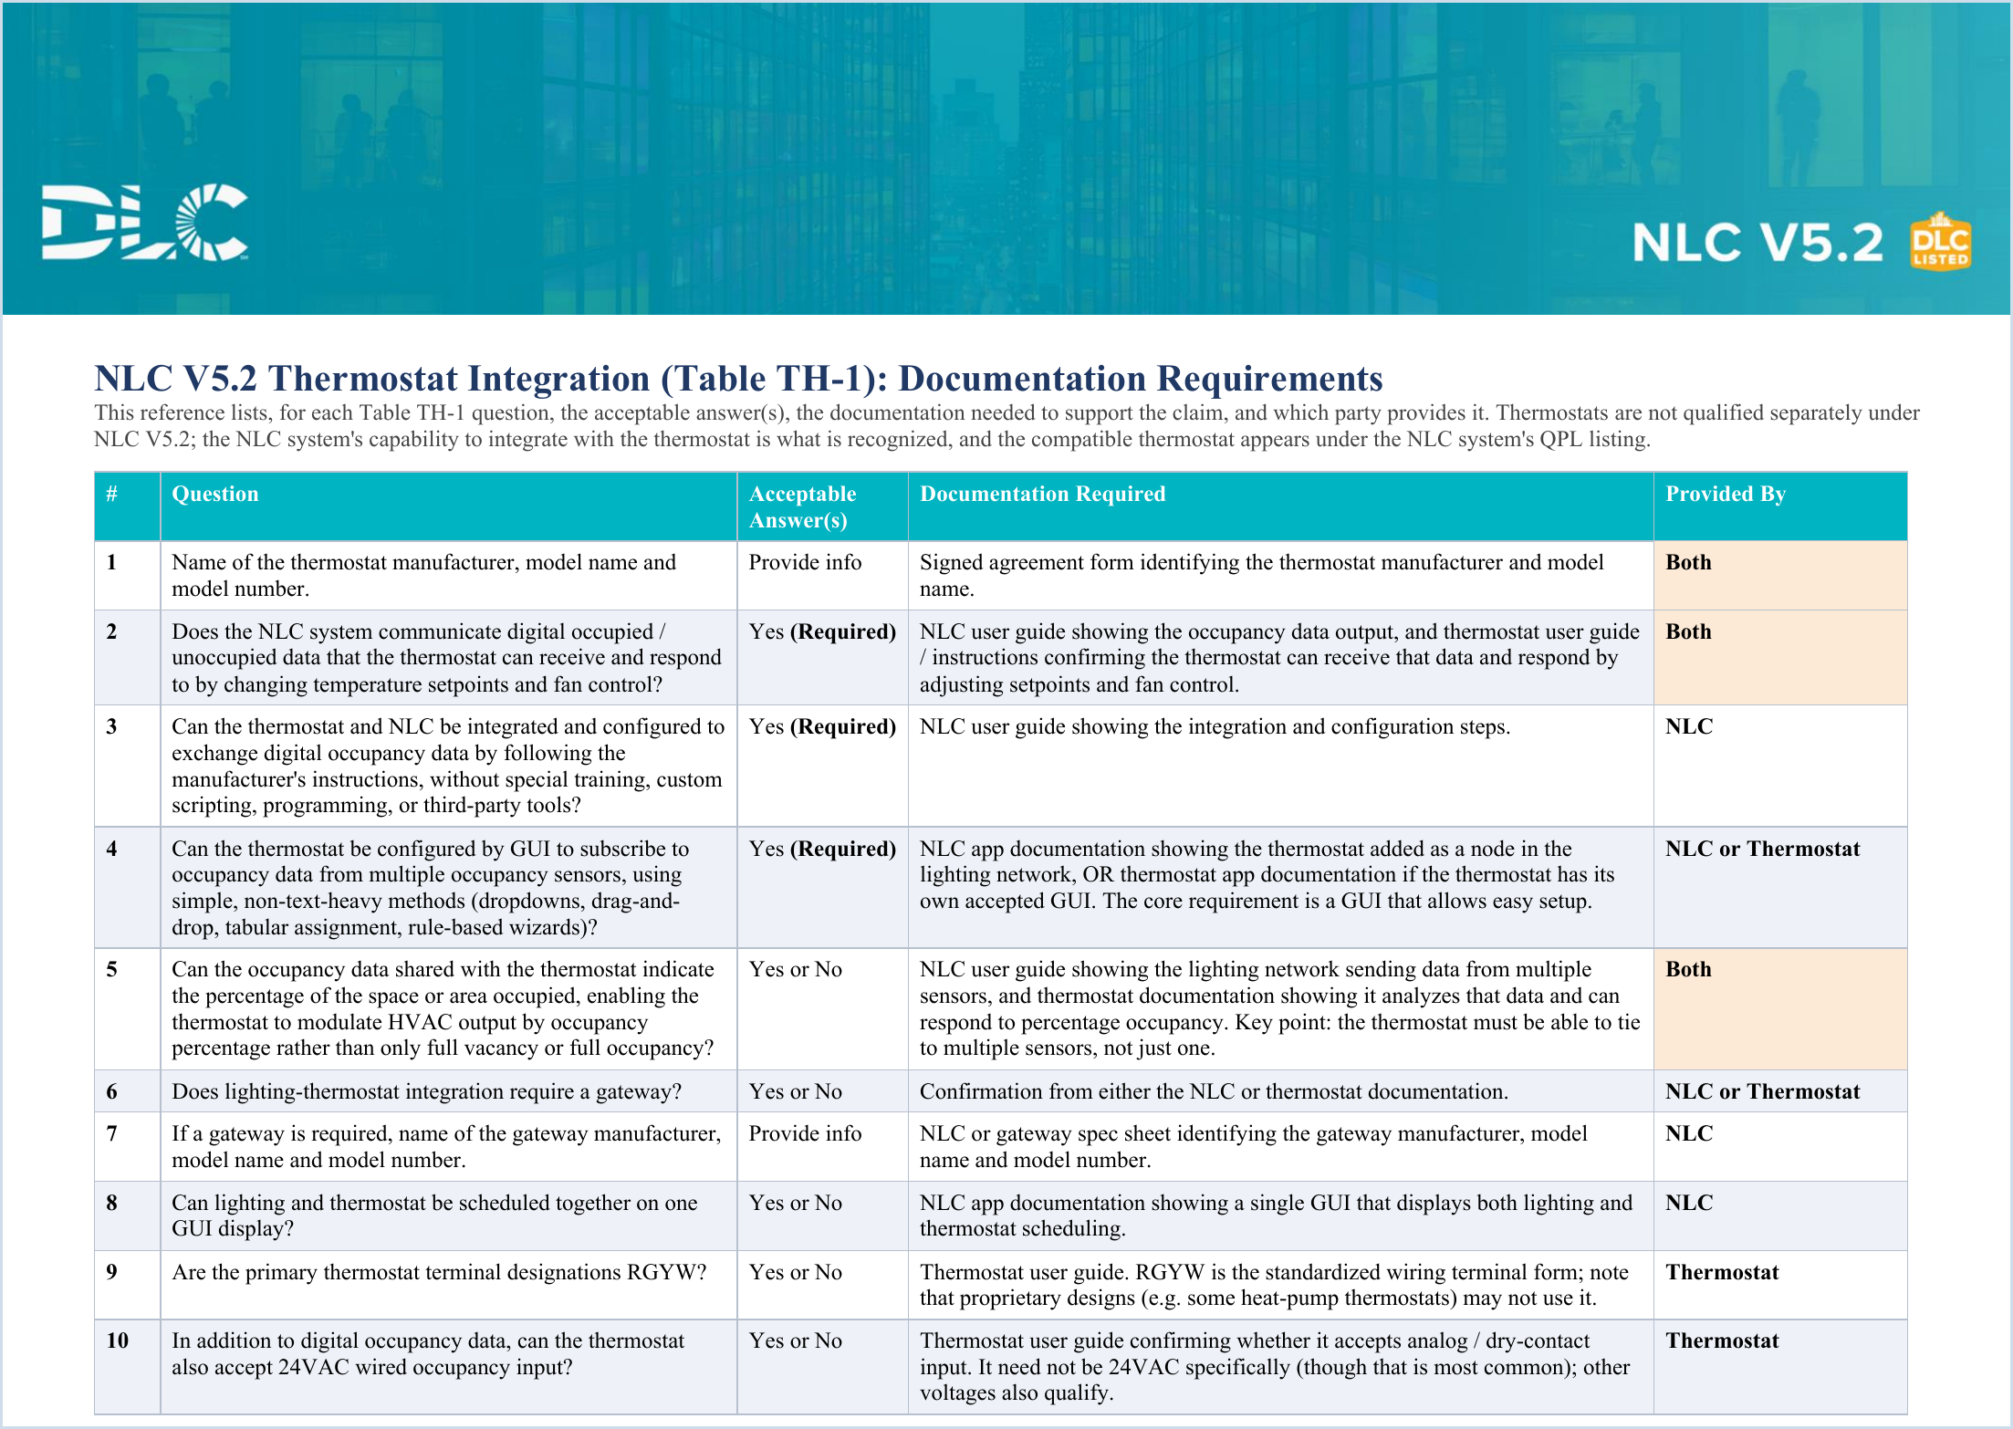



YOUR KEY RESOURCE
Start With the Submission Guide
The NLC–Thermostat Integration Submission Guide is your companion for Table TH-1.
READ THIS FIRST
WHAT’S INSIDE
The 13 questions
Every thermostat-integration question.
Acceptable answer(s)
What each answer must be - incl. the required “Yes” items.
Documentation required
The exact evidence that supports each claim.
Who provides it
NLC · Thermostat · Both - mapped per question.
The surest way to avoid documentation delays.
11
Notes:
I want to spend a moment on the Submission Guide because it determines whether your review goes fast or slow.
The guide maps every question to the documentation that supports it and who provides that documentation - the NLC manufacturer, the thermostat manufacturer, or both parties together.
NLC documentation is things like your user guide, manual or gateway spec sheet. Thermostat documentation means the thermostat’s own user guide showing it can receive and act on the occupancy data. And several questions require both.
The reason this matters: the most common cause of delay is documentation that’s missing or attributed to the wrong party. Reading the guide first is how you avoid that entirely.

Slide 13


THE GOLDEN RULE
For every question you answer:
attach a document AND cite the reference
Supporting document
Reference citation
+
Incorrect document or citation will hold up your review
12
Notes:
For every V5.2 question you answer, you owe two things: a supporting document, and a reference citation.
The document is the file that demonstrates the capability you’re claiming - from the correct party. The citation points to the exact place in that document where the capability is shown. We are looking for the specific page or section.

Slide 14




THE SUBMISSION PROCESS
Six Steps, Start to Finish
1
2
3
4
5
6
Log in & select
Open the form
Answer questions
Attach & cite
Signer info
Submit
NLC OEM – Update
Streamlined V5.2 update
Applicable V5.2 items
Doc + reference each
NLC–Thermostat Agreement
Send the application
Revising more than V5.2? Use the option at the bottom of the streamlined form to update additional sections of your listing at the same time.
13
Notes:
Here’s the whole submission at a glance - six steps. We’ll break these into two slides next, but I want you to see the shape of it first.

Slide 15
SUBMISSION WALKTHROUGH · PART 1
Steps 1–3: Access & Answer
1
Log in and select the application
2
Open the streamlined V5.2 update form
3
Answer the applicable V5.2 questions
14
Notes:
Let’s walk the first three steps:
Step 1: log in to the application portal and select the NLC OEM – Update application. That’s the right entry point for updating an existing listing. We will cover private labels in a separate section later.
Step 2: This opens a streamlined V5.2 update form. it shows only the new questions. so you’re not wading through your entire application again. If you do want to revise other capabilities as well, there is an option for that as well.
Step 3: answer the applicable questions - the thermostat-integration questions, the ANSI C137.9 question, or both, depending on your path.

Slide 16
SUBMISSION WALKTHROUGH · PART 2
Steps 4–6: Document, Sign & Submit
4
Attach documentation and cite the reference
5
Complete the Agreement signer information
6
Submit the application
15
Notes:
Steps four through six take you across the finish line.
Step 4: make sure for every answered question, you attach the supporting file AND cite the exact spot that demonstrates the capability. Do these together, question by question, so nothing slips through.
Step 5: complete the signer information for the NLC–Thermostat Manufacturer Agreement — the authorized signer’s name and email for both parties. Double-check these; a typo in an email address is a very common, very avoidable cause of delay.
Step 6: submit the application. If your application includes thermostat integration, it moves into an “Awaiting Signature” status, and DocuSign automatically routes the agreement to both signers. We’ll look at that status in a moment.

Slide 17

SPECIAL CASE
Integrating Multiple Thermostats
Its own set of questions
Each thermostat model
Its own signed Agreement
entered on your application
16
Notes:
A common real-world scenario: your system integrates with more than one thermostat. That’s fully supported; you can enter multiple thermostat models on the same application.
The thing to plan for is that each model is treated independently. Every thermostat model generates its own complete set of questions, and its own NLC–Thermostat Manufacturer Agreement.
So if you list three thermostats, you’ll answer three sets of questions and route three agreements - each signed by both parties. It’s not more difficult, but it is more of the same work, so budget your documentation and signer coordination accordingly.

Slide 18

THERMOSTAT INTEGRATION DOCUMENTATION
Understanding Thermostat Documentation
13
Questions in Table TH-1
3
Required to be answered Yes
Thermostats aren’t qualified separately
2
Parties supply the docs: NLC & thermostat
17
Notes:
Now we get into the core of the thermostat path. This is where most of the documentation work happens, so let’s frame it before the details.
13 questions. Each has an acceptable answer, a specific piece of documentation that supports it, and a designated party who provides that documentation.
A conceptual point that trips people up: thermostats are NOT qualified separately under V5.2. What gets recognized is your NLC system’s capability to integrate with the thermostat. The compatible thermostat then shows up under your NLC system’s QPL listing - it doesn’t get its own.

Slide 19


The Three Required Capabilities
For a thermostat listing, these core capabilities must be answered “Yes.” If your system lacks the core occupancy capability, it cannot be listed for thermostats.
Q2
Q3
Q4
Digital occupancy data
Easy integration
GUI sensor subscription
DOCS: Both
DOCS: NLC
DOCS: NLC or Thermostat
18
Notes:
Of the 13 questions, three are non-negotiable for a thermostat listing - they must be answered “Yes.”
Question 2 is the core: your NLC communicates digital occupied/unoccupied data, and the thermostat receives it and responds by changing temperature setpoints and fan control. This one requires documentation from both parties.
Question 3 is about ease of integration: the two systems integrate and exchange occupancy data by simply following the manufacturer’s instructions - no special training, custom scripting, or third-party tools. That’s NLC-provided documentation.
Question 4 is the GUI requirement: the thermostat can be configured through a graphical interface to subscribe to occupancy data from multiple sensors, using simple methods like dropdowns or drag-and-drop. Documentation can come from either party.
The hard line: if your system lacks that core occupancy capability, it cannot be listed for thermostats. So confirm these three before you invest in the rest of the application.

Slide 20


TABLE TH-1
Who Provides What: The Breakdown
Across the 13 questions, documentation responsibility splits four ways. Knowing this up front prevents the misattributed-documentation delays.
6
NLC only
3
Both parties
Q3, Q7, Q8, Q11, Q12, Q13
Q1, Q2, Q5
2
Thermostat only
2
NLC or Thermostat
Q9, Q10
Q4, Q6
19
Notes:
This slide is a cheat sheet on the documentation responsibility. It’s split in four ways.
Six questions are NLC-only - that’s the majority, and it’s your user guides, app documentation, manual with protocol details, gateway specs, and GUI information.
Three questions require both parties.
Two are thermostat-only - covering terminal designations and wired occupancy input. You’ll need to get those from the thermostat manufacturer before starting the application.
And two - can be satisfied by either party’s documentation.

Slide 21
Questions 1–6
# | Capability | Answer | Docs from
1 | Thermostat manufacturer, model name and model number | Provide info | Both
2 | NLC sends digital occupied / unoccupied data the thermostat acts on (setpoints + fan) | Yes — Required | Both
3 | Integrate & configure via manufacturer instructions — no scripting or third-party tools | Yes — Required | NLC
4 | Thermostat configured by GUI subscribes to occupancy data from multiple sensors | Yes — Required | NLC or Thermostat
5 | Occupancy data conveys the % of the space occupied (modulate HVAC output) | Yes / No | Both
6 | Does the lighting–thermostat integration require a gateway? | Yes / No | NLC or Thermostat
Every answered question needs a supporting document and a reference citation.
20
Notes:
Here are the first six questions in application form.
Question 1 is straightforward identification: thermostat manufacturer, model name, and model number - documented by both parties on the agreement.
Questions 2, 3, and 4 are the three required capabilities we just covered - note the amber “Required” flag.
Question 5 is about percentage occupancy - whether the data conveys how much of a space is occupied so the thermostat can modulate output, not just switch between fully occupied and fully vacant. This needs both NLC and thermostat documentation - NLC user guide showing the lighting network sending data from multiple sensors, and thermostat documentation showing it analyzes that data and can respond to percentage occupancy. Key point: the thermostat must be able to tie to multiple sensors, not just one.
Question 6 asks whether a gateway is required. Documentation from either the NLC or thermostat documentation
If yes, question 7 on the next slide asks for the gateway details.

Slide 22
TABLE TH-1 · REFERENCE
Questions 7–13
# | Capability | Answer | Docs from
7 | If a gateway is required: gateway manufacturer, model name & number (+ spec sheet) | Provide info | NLC
8 | Lighting and thermostat can be scheduled together on one GUI display | Yes / No | NLC
9 | Primary thermostat terminal designations are RGYW | Yes / No | Thermostat
10 | Thermostat also accepts 24VAC wired occupancy input | Yes / No | Thermostat
11 | Digital lighting-network protocol(s) used to transfer occupancy data | Choose all | NLC
12 | Additional data beyond occupancy (humidity, CO₂, particulates, pressure…) | Choose all | NLC
13 | GUI type(s) supported — mobile app, web browser, wallstation | Choose all | NLC
21
Notes:
Questions 7 through 13 are mostly conditional or descriptive - and mostly provided by NLC party.
Question 7 only applies if you answered “yes” to the gateway question: if you did, provide the gateway manufacturer, model name and number, and include a spec sheet.
Question 8 asks whether lighting and thermostat can be scheduled together on one GUI. NLC app documentation showing a single GUI that displays both lighting and
thermostat scheduling. Questions 9 and 10 are thermostat-provided - whether the terminals are the standard RGYW form, and whether it also accepts a wired occupancy input, commonly 24VAC though other voltages qualify.
Questions 11 through 13 are “choose all that apply”: the digital protocols used, any additional data beyond occupancy like humidity or CO2, and the types of user interface supported - mobile app, web browser, or wallstation. All NLC-documented from your user guide.

Slide 23



AFTER YOU SUBMIT
The “Awaiting Signature” Status
Both parties must sign
Held until fully signed
Missing a signature = no advance
Verify names & emails
22
Notes:
Once you submit a thermostat application, it doesn’t go straight into review - it lands in an “Awaiting Signature” status.
On submission, DocuSign routes the NLC-Thermostat Manufacturer Agreement to both signers. This Agreement formalizes both manufacturers' confirmation that their systems are compatible and integrate as described in the application.
Both parties must sign. If a signature is missing, the application will not advance into review; So it’s important to verify both signers’ names and email addresses before you submit, because a wrong email means the agreement never reaches the person who needs to sign it. We recommend keeping the thermostat manufacturer informed as you proceed with the application, so the DocuSign is signed promptly and your submission isn't held up.

Slide 24

PATH B · THE OTHER ROUTE
ANSI C137.9 Configuration Reporting
1
2
3
Understand the standard
Answer “Yes”
Attach a sample report
Don’t forget: If you answer “Yes” to the C137.9 configuration-report question, the sample report must be attached - or the review stalls.
23
Notes:
Now moving to Path B. It’s a path to V5.2 for systems that aren’t doing thermostat integration.
ANSI C137.9 is about your system’s ability to generate a standardized configuration report. Three steps.
One: understand the standard. The ANSI C137.9 requirements are on the ANSI website — review them before you claim the capability so you know what a compliant report looks like.
Two: answer “Yes” to the ANSI C137.9 configuration-report question in the update questionnaire.
Three: attach a sample configuration report generated by your system. That sample is what substantiates the claim.
The one pitfall here is simple but common: if you answer “Yes” and forget to attach the sample report, the review stalls. So make sure you attach a sample report.

Slide 25

LEARN FROM OTHERS
Common Mistakes to Avoid
Missing signatures
Incorrect document or citation
“No” to a required capability
Single-source where both needed
Docs that don’t show the capability
Incomplete gateway details
Avoid all seven
No sample C137.9 report
and you’re set up for a smooth, first-pass review under V5.2.
24
Notes:
Common mistakes to avoid- the seven issues that account for most review delays. Avoid these and you’re in great shape.
One: missing signatures - the application sits in Awaiting Signature until both parties sign.
Two: a missing upload or citation – make sure to reference the right documentation from the right party. And cite the exact location in the document.
Three: answering “No” to a required capability - without the core occupancy capability, you can’t list for thermostats.
Four: single-source documentation where both are required - the digital-occupancy-response and percentage-occupancy questions need NLC and thermostat docs.
Five: thermostat documentation that doesn’t actually show the capability - the spec sheet must demonstrate it can receive and respond to occupancy data from lighting network.
Six: incomplete gateway details - manufacturer, model name and number, plus a spec sheet.
Seven: answering “Yes” to C137.9 but not attaching the sample report.
Avoid all seven and you’re setup for a smooth first pass review under v5.2.

Slide 26

Private Label Systems Under V5.2
A private label qualifies under the same Technical Requirements version and scope as its parent OEM system - if the OEM is V5.2, the private label can qualify under V5.2.
New Private Label
Private Label Update
Thermostat-integrated? Two agreements
Avoid these private-label delays
5-yr warranty under the private-label brand, covering NLC hardware
1. Private Label Agreement
2. NLC–Thermostat Manufacturer Agreement
Direct product-page URL — not the main company website
All agreements signed with correct emails
For pre-production: launch within the two-week window
25
Notes:
Blue color codes: 005A8B; 0086C9; 4FC6E0
If you sell through private label, this slide is for you. A private label qualifies under the same Technical Requirements version and scope as its parent OEM system. So if the OEM system is listed under V5.2, the private label can qualify under V5.2 for that same scope.
So before you prepare to submit an application, confirm with your OEM partner first that they have updated their listing to V5.2
Choose the right application: New Private Label if you’re listing a private label system for the first time; Private Label Update if you’re updating an existing listing that’s already qualified on the QPL. The dropdown walks you through selecting the OEM or the private-label system accordingly.
Important wrinkle for thermostat-integrated systems: there are two DocuSign agreements - the regular Private Label Agreement AND the new NLC–Thermostat Manufacturer Agreement, one per listed thermostat. All of them must be signed before the application advances.
And watch the private-label-specific delays on the right - especially the warranty document under the private-label brand covering the NLC hardware, and a direct product-page URL rather than your main website.

Slide 27
FINAL CHECK
Your Pre-Submission Checklist
Submission Guide read
Every answer documented + cited
Required capabilities are “Yes”
Dual-source docs provided
Gateway / C137.9 items complete
Signers confirmed
26
Notes:
Before you hit submit, run this six-point checklist.
One: you’ve read the Submission Guide and know which party provides each document. Two: every answer has both a document and a precise citation. Three: the three required capabilities - questions 2, 3, and 4; are confirmed “Yes” for thermostat listings. Four: for the dual-source questions, you’ve provided both parties’ documentation. Five: your gateway details and spec sheet, or your C137.9 sample report, are attached as applicable. Six: signer names and emails are confirmed for every required signature.
If you can check all six,, you’ve eliminated essentially every common cause of delay.

Slide 28
WRAPPING UP
Key Takeaways
Two paths, one goal
Document and cite everything
Get every signature
27
Notes:
Let’s bring it home with three takeaways.
One - two paths, one goal: meet thermostat integration OR ANSI C137.9 to qualify your Indoor listing under V5.2. You choose the path that fits your product.
Two - document and cite everything. Ensure every answered question is supported by the right document and a precise citation. This single habit prevents the majority of delays.
Three - get every signature. For thermostat applications, both parties must sign in DocuSign before the application advances, so confirm names and emails up front.

Slide 29


WRAPPING UP
Resources
Update a Listed System to NLC V5.2
https://designlights.org/our-work/networked-lighting-controls/qualify-a-system/update-listed-systems/
NLC–Thermostat Integration Submission Guide
https://designlights.org/wp-content/uploads/2026/08/NLC-Thermostat-Integration-Submission-Guide.pdf
ANSI C137.9 standard
https://webstore.ansi.org
Private Label Update to V5.2
https://designlights.org/our-work/networked-lighting-controls/qualify-a-system/private-label-applications/
Thank you — questions welcome.
28
Notes:
This slide has links to the website to everything that was referenced: the Update procedure, the Submission Guide, the ANSI C137.9 standard, and the update process for private labels. We’ll leave this slide up.
We’re happy to take your questions now.

