Slide 1
DLC Logo Use and Misuse: How to Protect Your Projects and Incentives
July 22, 2026

Slide 2
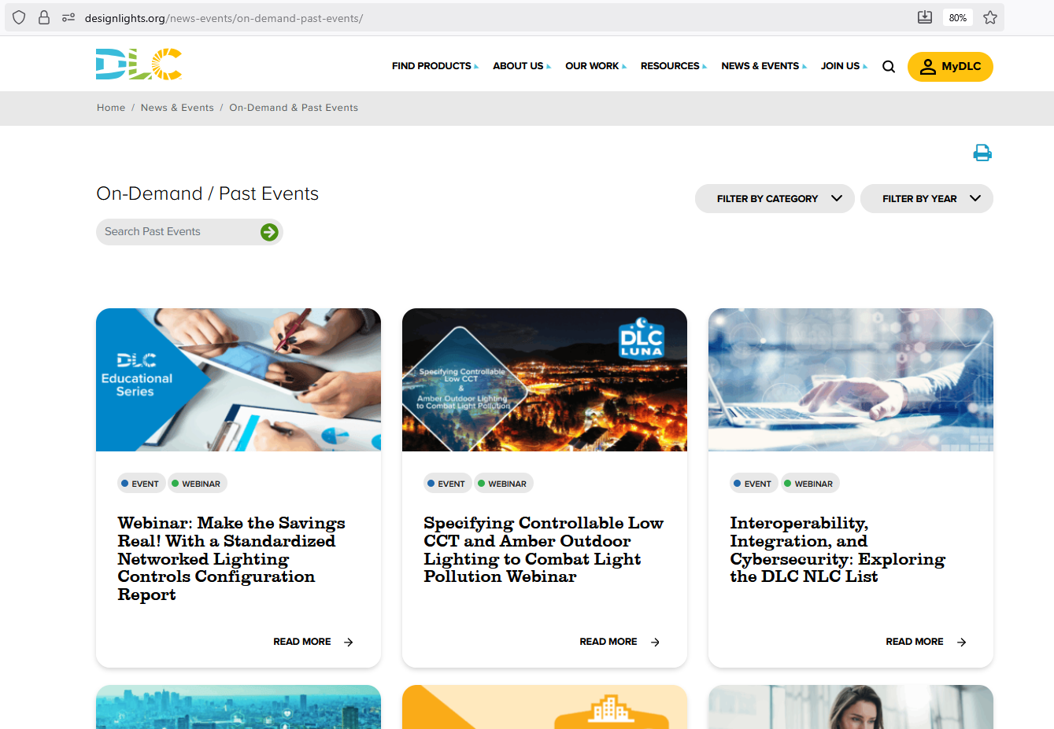
Welcome!
Slides and recorded webinar will be posted on the DLC News & Events page at https://designlights.org shortly after today’s presentation
All attendees are automatically muted
Notes:
Before we get started, I’ll take care of a little housekeeping. If there’s something you’d like to go back and see again or you’d like to share this webinar with someone who couldn’t attend, the slides and recording will be posted on our website.
I should also let you know that all attendees have been automatically muted, and we’ll keep it this way for the entire webinar. (click)

Slide 3


Webinar Orientation
Questions will be held until the end during a live Q&A
  Use the Question pane (not Chat) to submit for Q&A
Notes:
But of course we still want you to be able to communicate. If you have any questions, you can use the question pane. You can locate this at the top right by clicking on the speech bubble with the question mark. You can see it in this screenshot underlined in green. The question pane is distinct from the chat pane, which has the two layered speech bubbles. We will not be using the chat pane during this call. So be sure to use the question pane only.
We’ll be answering some questions through text throughout the webinar, but we won’t pause the presentation to answer. However, near the end of the webinar we will hold a live Q&A session. We will choose some of the more common questions to answer live, so keep them coming throughout the call so we know what is most relevant to you. (click)

Slide 4

The DesignLights Consortium is an independent, nonprofit organization providing decision makers with data and resources on quality lighting, controls, and integrated building systems to reduce energy, carbon, and light pollution.
Notes:
For those of you who may joining us for the first time, I should mention that the DLC is a nonprofit organization with a mission to reduce energy, carbon, and light pollution. We do this by delivering the right information to decision makers, and one of the main ways we do that is by creating technical requirements that underpin our qualified product lists which support the majority of incentive programs across North America. (click)

Slide 5
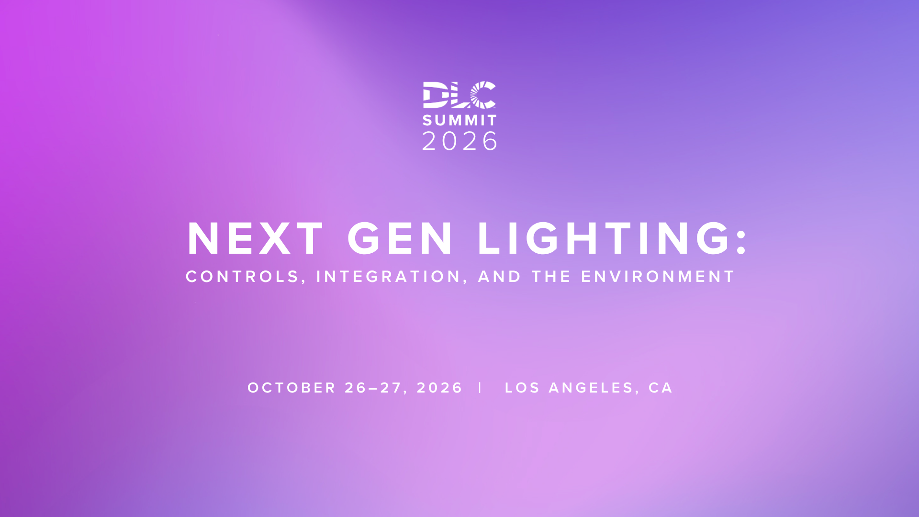
EARLY BIRD PRICING ENDS JULY 31ST
EARLY BIRD: $600 STANDARD: $750
Notes:
We’re going to continue to answer questions today, but before we run out of time I want to be sure I mention our summit which will provide much more opportunity to discuss NLC-HVAC integration than we accomplish in a Q&A session. I want to quickly show you our agenda, but first please note that early pricing is available through the end of July, so you have about three weeks left to take advantage of that.

Slide 6





Summit Agenda
Morning
Afternoon
Next Gen Lighting Savings:
Scaling Advanced Controls
Next Gen Lighting Programs:
Market Realities
&
New Opportunities
Next Gen Buildings: Integrating Lighting
and HVAC for Whole Building Savings
Capturing Controls in TRMs for Next Gen Savings
Lighting Controls and Light Pollution: Aligning Energy Savings and Environmental Responsibility
working session
Notes:
As you can see, the entire summit is centered around lighting controls. Each session will feature a panel of experts rather than a presentation and we’ll be discussing the challenges the industry faces when building incentive programs around controls.
Talk about how to handle LED-to-LED retrofits
Integrating building systems
Building a framework for controls programs through technical resource manuals
How to address both energy savings and light pollution
We’ll end the day by rolling up our sleeves and applying what we’ve learned day to come up with some solutions that we can bring home to our colleagues

Slide 7
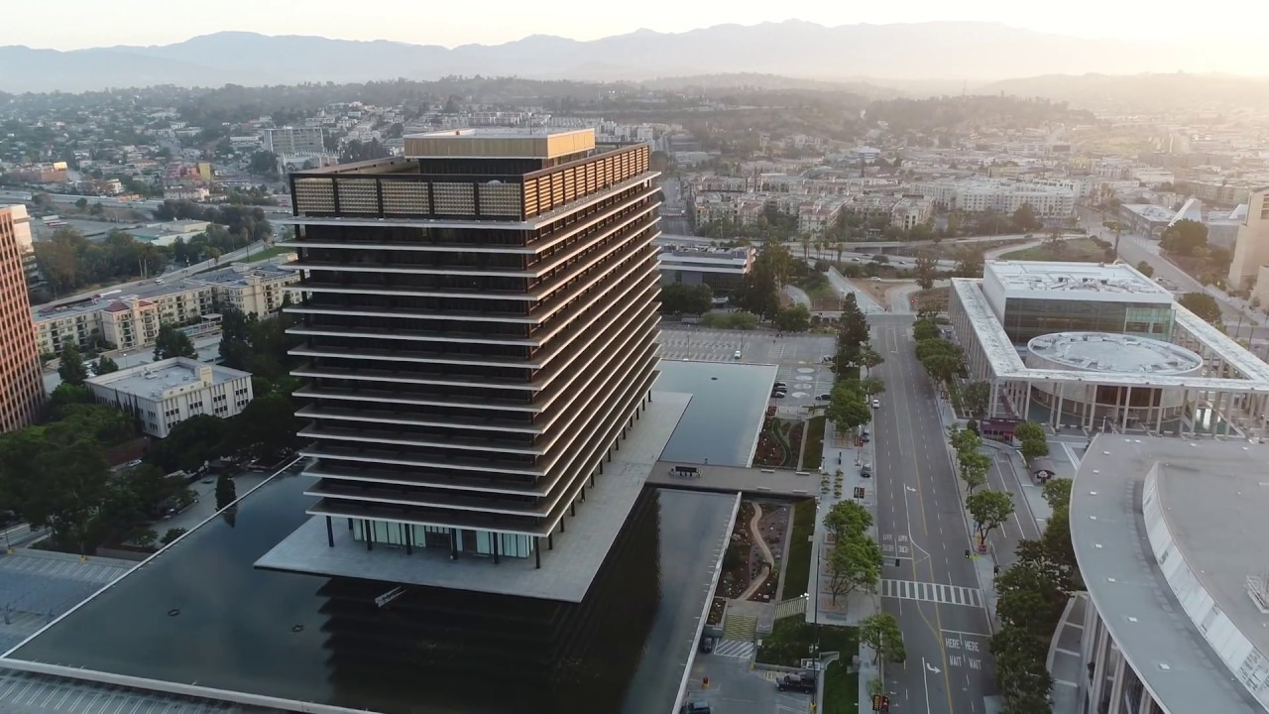

Thank you to our hosts!
Notes:
We’re going to get right back to the questions, but as a final note on the summit I want to thank our hosts, the Los Angeles Department of Water & Power, for making it possible to bring the industry together in this way. Now, back to the questions!

Slide 8
Agenda
Agenda
Welcome, Introductions & Agenda Review
QPL Integrity Policy V1.0
Common forms of misuse
Q&A
Best practices verifying qualification
The Role of the DLC Logo
Why Accuracy Matters
DLC qualification and safety certification
Logo Violation Enforcement
Live QPL Demonstration
Notes:
Not going to go though each one, but please note that the presentation today will end with a Live QPL demonstration as well as

Slide 9
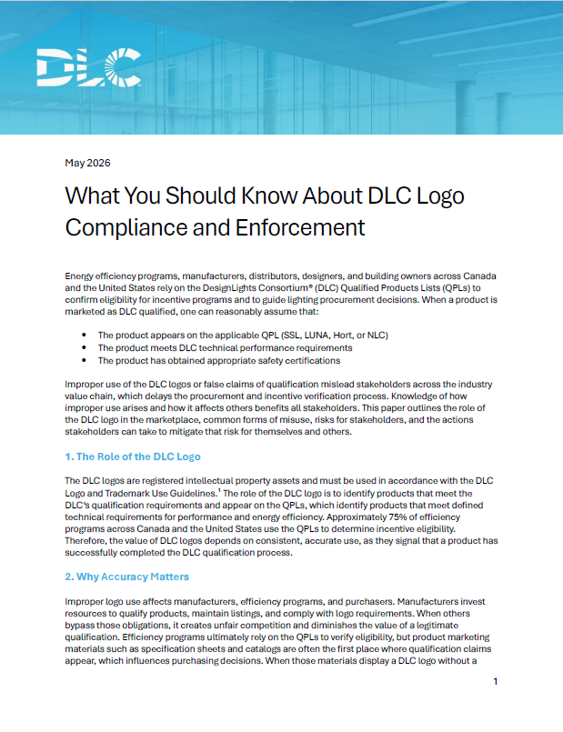
Webinar Objectives
How to use the DLC logo correctly
How to identify unqualified products
How the DLC enforces its logo policy
Best practices verifying qualification
How to use the SSL QPL’s new features
Notes:
Webinar is based on the report we published in May
https://designlights.org/resources/reports/what-you-should-know-logo-compliance/
Read off objectives

Slide 10


Presenters
Andrew Antares
Project Manger of Technical Development & QPL Integrity
Kasey Holland
Senior Technical Manager
aantares@designlights.org
logo@designlights.org

Slide 11

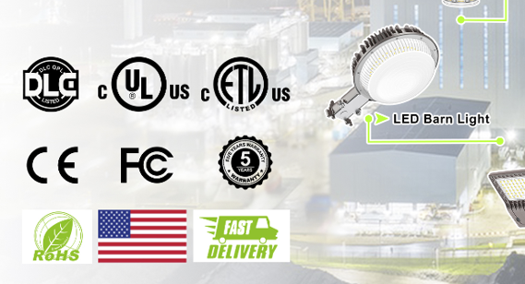
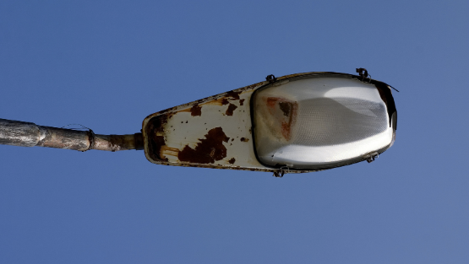
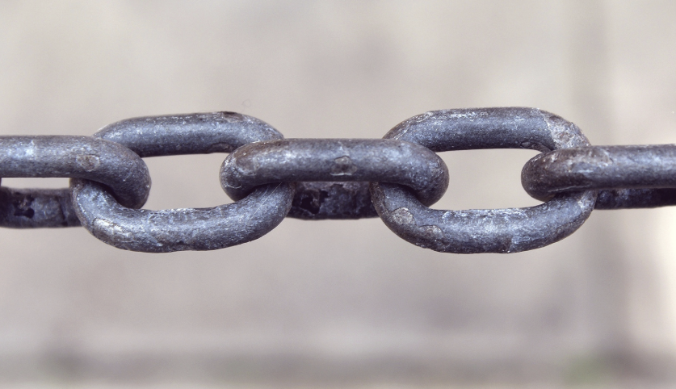
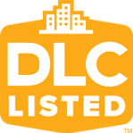
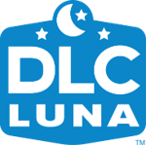
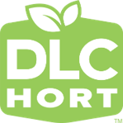
DLC QPL Integrity Policy Version 1.0
(QPL Integrity V1.0)
Logo & Trademark Use & Guidelines
Logo & Trademark Violation Enforcement
SSL, LUNA, Hort Surveillance Policies
Product Misrepresentation Investigation
Notes:
Upcoming policy update is a combination of four policies
Today we will focus on parts of the logo use policy and parts of the logo violation enforcement process

Slide 12
QPL Integrity Policy V1.0 Timeline
Release Draft
8/24/26
DLC Controls Summit
10/26/26 – 10/27/26
Release Final Version
1/11/27
Draft Webinar
9/2/26
Final Version
Webinar
1/20/27
August
September
October
November
December
January
6-Week Public Comment Period
8/24/26 – 10/2/26
Outreach & Revisions
10/5/26 – 11/13/26
Notes:
Planning to do only one draft

Slide 13
The Role of the DLC Logos
Notes:
In this section I will go over the various DLC logos and trademarks and summarize how they should be applied, but this isn’t a replacement for reading the logo policy which has many more nuances

Slide 14
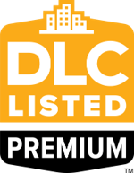

DLC logos & trademarks
DO NOT COPY
DO NOT COPY
DO NOT COPY
DO NOT COPY
DO NOT COPY
DesignLights Consortium®
DLC®
Notes:
Quick look at each logo/trademark, more to come later

Slide 15

Logos retired in 2022
Notes:
Any product with these logos is suspicious

Slide 16
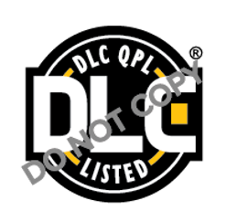
Poll: Did you know that the DLC updated its logos?
DO NOT COPY

Slide 17
Who can use DLC logos?
Who can use it?
DO NOT COPY
DLC member programs
Lighting Testing Laboratories
Manufacturers and Distributors (who are selling DLC-listed products and only with explicit permission)
DLC Program Logo

Slide 18
Who can use DLC logos?
Who can use it?
DLC Product Logos
Manufacturers with DLC-listed products
Distributors selling DLC-listed products
DO NOT COPY
DO NOT COPY
DO NOT COPY
DO NOT COPY
Notes:
I will be using the main SSL/NLC product logo for most examples today, but rules apply to all

Slide 19
Who can use DLC trademarks?
Who can use them?
DesignLights Consortium®
DLC Member Programs
Manufacturers
Distributors
DLC®

Slide 20
Why Accuracy Matters
Notes:
In this section I will review why logo violations harm DLC stakeholders and the various ways a product might experience a change to it’s DLC listing status

Slide 21
The DLC mark signifies rigorous review
DLC requires comprehensive performance and quality
Efficacy
Power quality
Lifetime
Spectral quality
Lighting distribution
Controllability
Product application
Application review is exhaustive
Independent test reports
Hundreds of product variations
Interactions between the requirements
Spec sheets
Warranty documents
Safety certifications
Notes:
People don’t simply pay to be on the QPL
Listing means the product is truly high quality
This is why manufacturers list and this is why programs require DLC qualification

Slide 22

Unfair competition for listing manufacturers
The DLC logo is a selling point for lighting products and control systems
Listing manufacturers invest significant time and resources to obtain qualification
Bad actors can secure sales without the investment when they bypass qualification

Slide 23
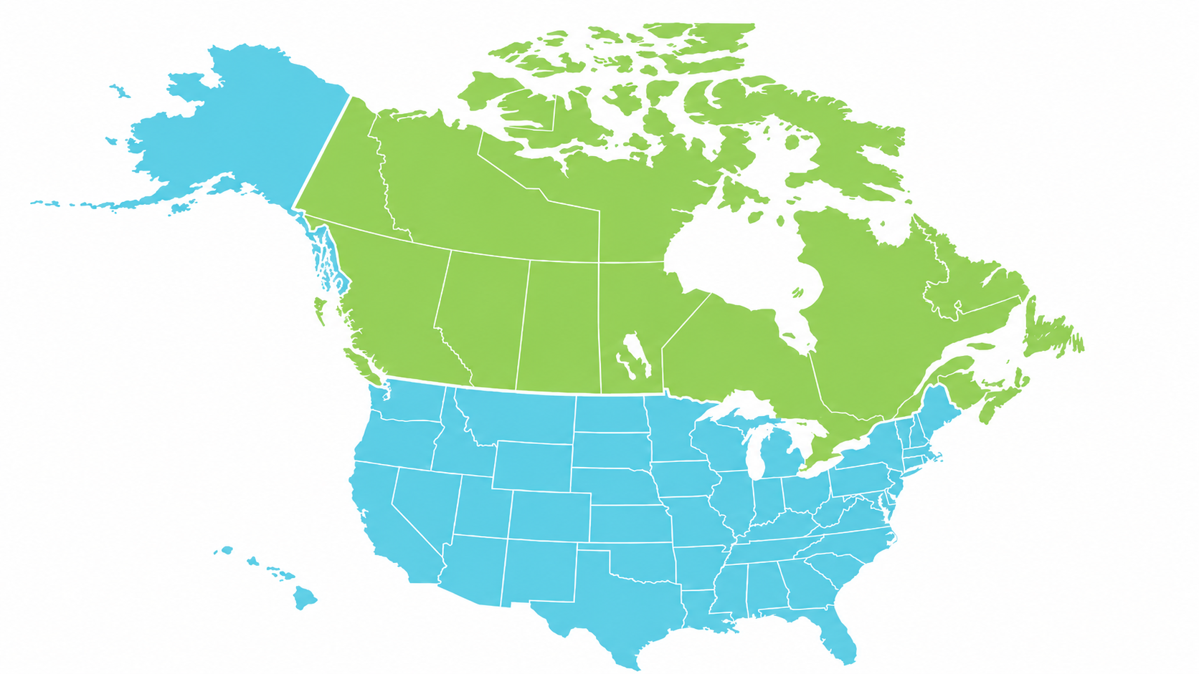
Poll: What percent of energy efficiency programs across the United States and Canada rely on the DLC QPLs?
57%
25%
96%
75%
Notes:
Energy efficiency programs are also impacted when products misuse the DLC logo

Slide 24
What percent of energy efficiency programs across the United States and Canada rely on the DLC QPLs?
75% of lighting energy efficiency programs across the United States and Canada rely on the DLC QPLs
Source: BriteSwitch
Notes:
Misuse of the DLC logos stands to gum up the process of moving incentives through the system and completing projects on time

Slide 25

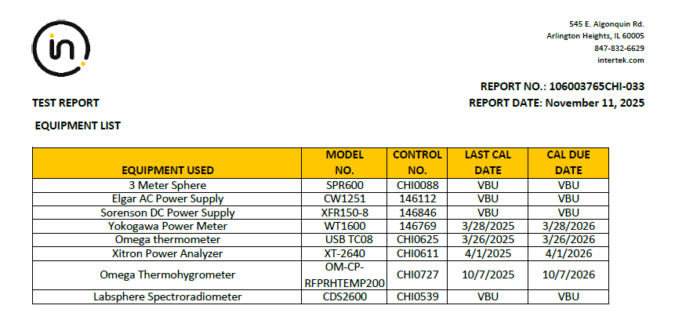
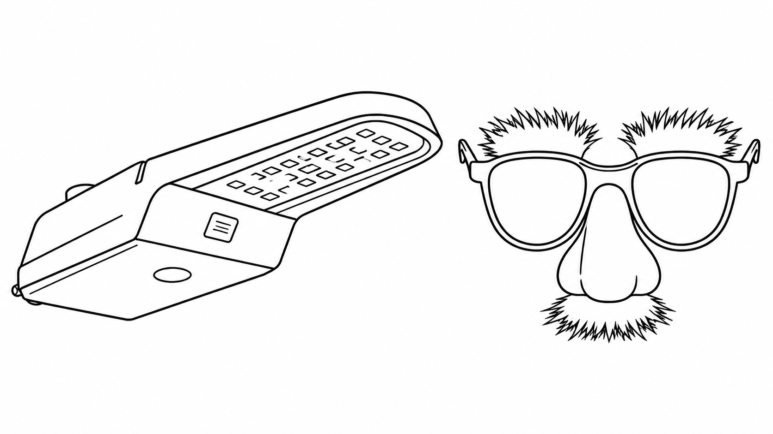
Many Reasons for Changes to Listing Status
Surveillance Testing
DO NOT COPY
SSL V5.1
SSL V6.0
Product Misrepresentation
DO NOT COPY
DO NOT COPY
SSL V5.1
SSL V6.0

Slide 26
Changes to Listing Status: Products that did not update
October 9
Last day to submit applications to update V5.1 & V1.0 products to V6.0 and V.20
December 15
DLC will delist products not qualified under V6.0 & V2.0 requirements
October
November
December
SSL V5.1
SSL V6.0
After December 15, products not updated to SSL V6.0 & LUNA V2.0 should not display DLC logos & trademarks
LUNA V1.0
LUNA V2.0
Notes:
We are in the middle of a policy update
Products who haven’t updated by the end of the year must remove claims of DLC qualification

Slide 27

Changes to Listing Status: Premium products moved to standard
October 9
Last day to submit applications to update V5.1 & V1.0 products to V6.0 and V.20
December 15
DLC will delist products not qualified under V6.0 & V2.0 requirements
DO NOT COPY
DO NOT COPY
October
November
December
SSL V5.1
SSL V6.0
Premium Requirement Areas
Efficacy
Chromaticity
Discomfort glare
Controllability
Lumen maintenance
Driver lifetime
SSL QPL shows classification history
Notes:
Products may change from Premium to Standard classification during a policy update
This is when a product is still listed, but no longer meets Premium requirements in new policy
Controllability is now a Premium requirement under V6.0, biggest change

Slide 28
Changes to Listing Status: Post-Qualification Issues
Surveillance Testing
Product still meets the technical requirements
Product performance/features have not shifted since initial qualification
SSL
LUNA
Hort
Product Misrepresentation
Features that should be associated with model number NOT present
Product claims features NOT represented on QPL
Performance not in line with QPL listing
SSL
LUNA
Hort
NLC
Notes:
Surveillance only applies to SSL, LUNA, and Hort
Product misrepresentation applies to all programs

Slide 29
Changes to Listing Status: Product was discontinued or not renewed
Manufacturer voluntarily delisted discontinued product
NLC has always required an annual renewal
SSL V6.0 & LUNA V2.0 will require annual renewals

Slide 30
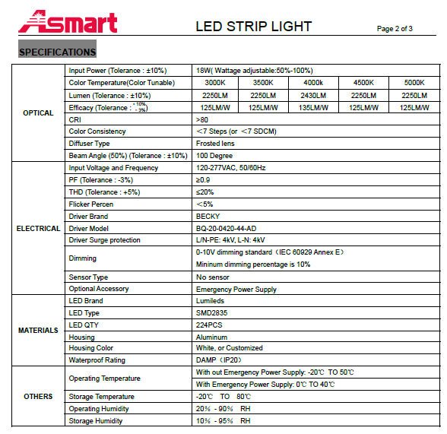


It starts with specification sheets
Notes:
This presentation is designed to provide tips to all segments of the lighting industry, but we will mostly focus on tips for manufacturers
Because manufacturer specification sheets are the first way customers interact with a product and may assume a logo assures DLC qualification

Slide 31
It starts with specification sheets
Building owners
Specifiers
Distributors
Installers
Efficiency Programs
Notes:
Assuming a product that has falsely claimed qualification has impacts all the way down the industry value chain
If a product that was falsely representing DLC qualification gets to an efficiency program incentive review, time and money lost have been lost
As we’ve seen, there are many reasons for changes to DLC listing status which means documentation isn’t always accurate
Although the DLC logo on a spec sheet is a good starting place, finding the product on the QPL is the only way to confirm eligibility

Slide 32
DLC Qualification and Safety Certification

Slide 33
Safety certification review
DO NOT COPY
Not a safety certification body
“DLC qualified, “a DLC qualification,” or “DLC listed”
OSHA
SCC
Intertek - Authorization to Mark
CSA – Certificate of Compliance
UL - Certificate of Compliance or Notice of Authorization
Notes:
DLC not a certification body
Term certification is more appropriately used when it is a process that must happen before a product can be sold
DLC qualification confirms presence of safety certifications, but is not a requirement for a product to be available for purchase
Consequences for misusing the DLC logo come only from the DLC, which is not a governmental body, don’t affect ability to sell a product
These are the documents DLC reviews
In US, OSHA approves labs to perform safety certifications
Intertek
UL
In Canada, the Standards Council of Canada approves labs
Canadian Standards Association

Slide 34
Common Forms of Misuse on Product Specification Sheets
Notes:
In this section I will review some of the ways we observe logo violations so you know what to look out for, and again I will be focusing on the SSL product logo

Slide 35
Violation: Logo on non-listed product
Logo appears on non-listed product
DO NOT COPY
Why is it a violation?
Only DLC-listed products that currently appear on the QPLs can display the logos

Slide 36
Violation: Old Logo
Old product logo (can also be a good sign that the product is not DLC qualified)
Why is it a violation?
DLC policy requires that all products use current logos

Slide 37
Violation: Wrong logo
Program logo instead of product logo
DO NOT COPY
Why is it a violation?
Program logos cannot be used on specification sheets

Slide 38
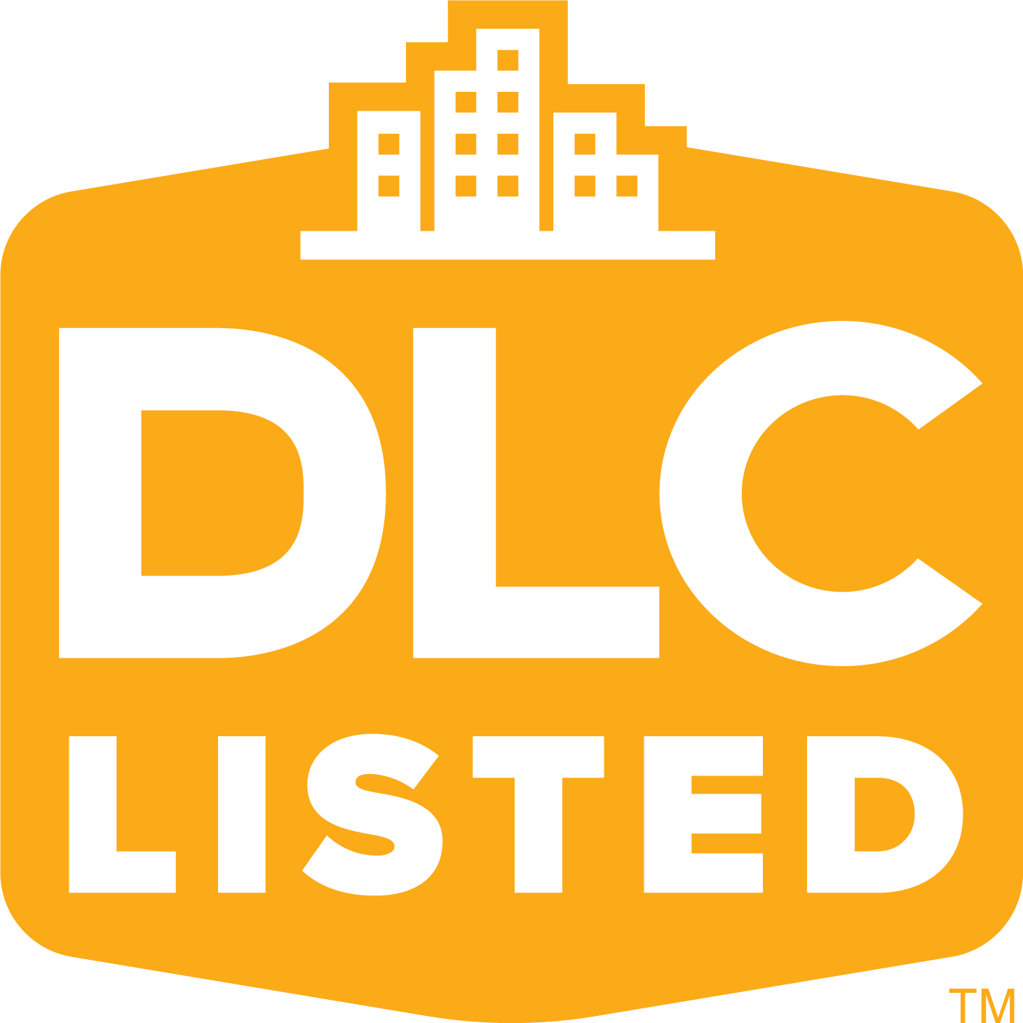
Logo Violation: Qualification mix on specification sheet
Correct logo, but spec sheet includes a mix of qualified and unqualified product variations
DO NOT COPY
DO NOT COPY
Why is it a violation?
DLC requires that spec sheets identify that not all products are DLC qualified
DO NOT COPY

Slide 39
Poll: When is a DLC qualification transferable to other brands?
Never
When different brands under one OEM have identical products
When a company privately labels an OEM’s DLC-listed product
Both B & C

Slide 40
Violation: Separate brands without separate DLC qualifications
OEM Brand 1
Correct logo on qualified brand 1, but brand 2 does not hold their own DLC qualification
DO NOT COPY
OEM Brand 2
Why is it a violation?
DO NOT COPY
All brands under an OEM must hold separate DLC qualifications

Slide 41
Violation: Private label products without DLC qualification
OEM
Correct logo on qualified OEM product, but the private labeler does not hold their own DLC qualification
DO NOT COPY
PL
Why is it a violation?
DO NOT COPY
All brands privately labeling an OEM’s products must hold their own DLC qualification

Slide 42
Logo Violation Enforcement

Slide 43
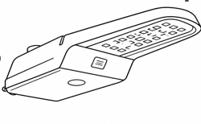
Outcome: Modify Marketing Materials
DLC Listed
Violator
DLC Listed
Violator
Non-DLC Listed
Violator
Non-DLC Listed
Violator
DO NOT COPY
DO NOT COPY

Slide 44
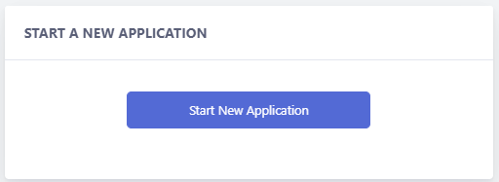
Outcome: Assist with an application
New Product Application
Update Application
Private Label Application
Non-listed OEMs
Adding brands, adding products to families
Listing privately labeled products if identical OEM products are already listed

Slide 45
Outcome: Delist, suspension, or hold (rare cases)
Products are delisted from the QPL and will require a new product application to be re-listed
Offending company is suspended from applying for DLC qualification
Pending applications are placed on hold until the matter is resolved

Slide 46
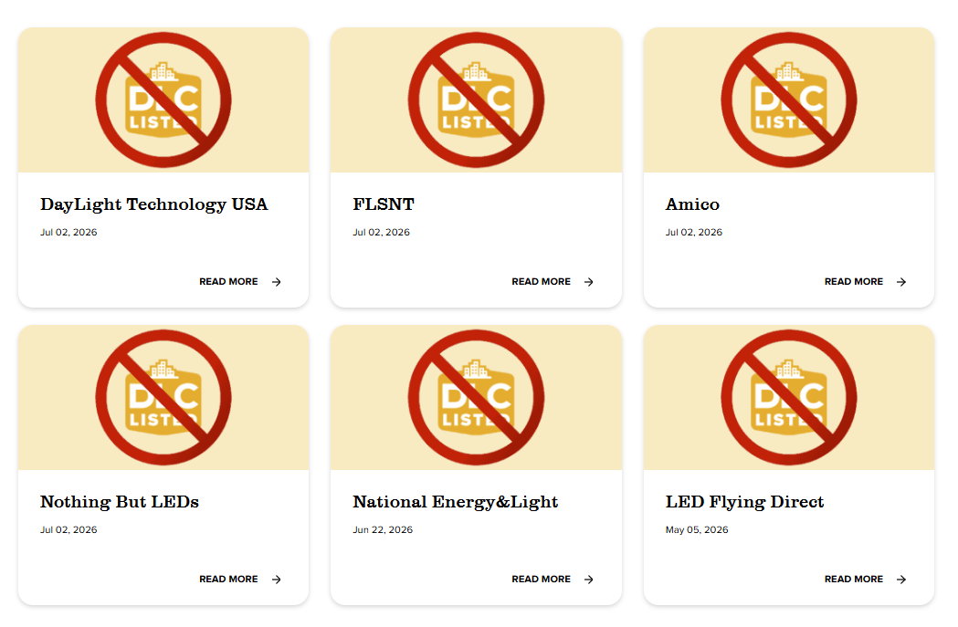
Outcome: Posting public notices

Slide 47
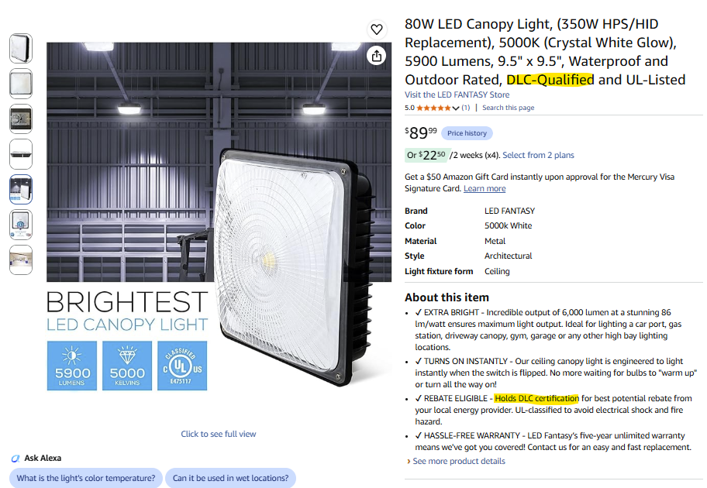

Outcome: Report and permanently remove Amazon listings
211 listings removed &
306 corrected during recent pilot

Slide 48
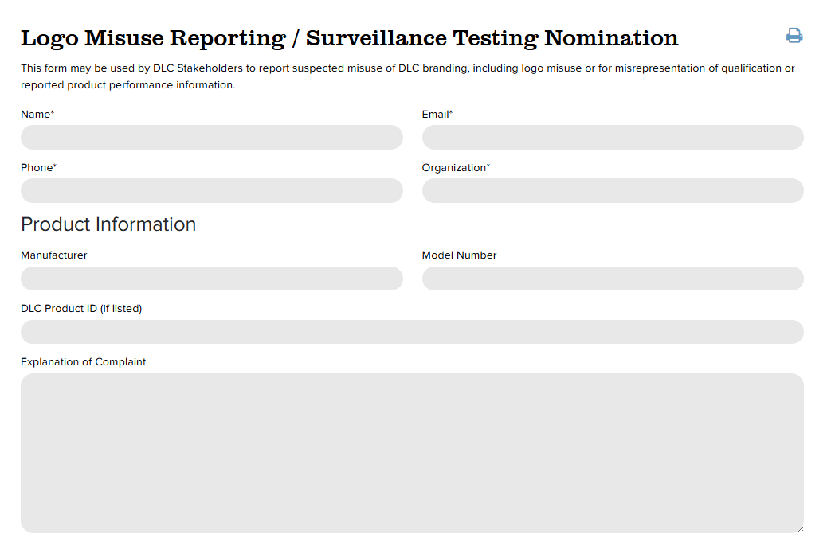
How can you help enforce DLC logo compliance?
designlights.org/report-logo-misuse

Slide 49
Best Practices for Best Practices Verifying Qualification

Slide 50

Best practices for manufacturers
Communicate to your private labelers that they are required to obtain their own DLC qualification
Ensure that all marketed model numbers align with QPL listings
Clearly indicate which variations are qualified
Use only official, current DLC logo files
Include DLC product IDs on your spec sheet

Slide 51
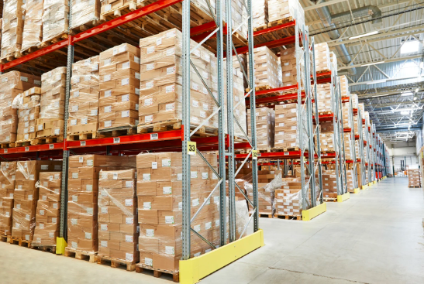
Best practices for distributors
Verify DLC qualification claims on the QPL before selling or purchasing products
Request DLC Product IDs when in doubt
Clearly identify which variations are qualified
Display both the manufacturer and brand name to prevent false private label claims

Slide 52
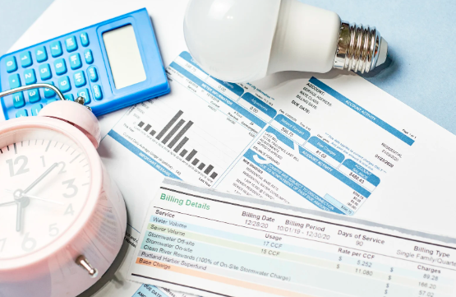
Best practices for efficiency programs
Request the DLC Product ID when reviewing incentive submissions
Not rely solely on DLC logo usage and verify DLC qualification status directly through the QPL
Avoid custom reviews of non-DLC listed products by educating trade allies about verifying DLC qualification prior to purchase

Slide 53

Best practices for specifiers and purchasers
Review QPL listing status prior to procurement to avoid losing out on potential incentives
Request DLC Product IDs when in doubt

Slide 54
Live QPL Demonstration
Notes:
Distinction between search and filter
Using spec shoots and product images
Updated model number search
New controls options tables

Slide 55
Ideal qualification verification process
2a
The QPL returns a product listing that matches the spec sheet. The product is qualified.
1
Search by model number, DLC product ID, DLC Family Code
2b
The QPL returns a product listing that does not match the spec sheet.
The product is not qualified.

Slide 56
Q&A

Slide 57

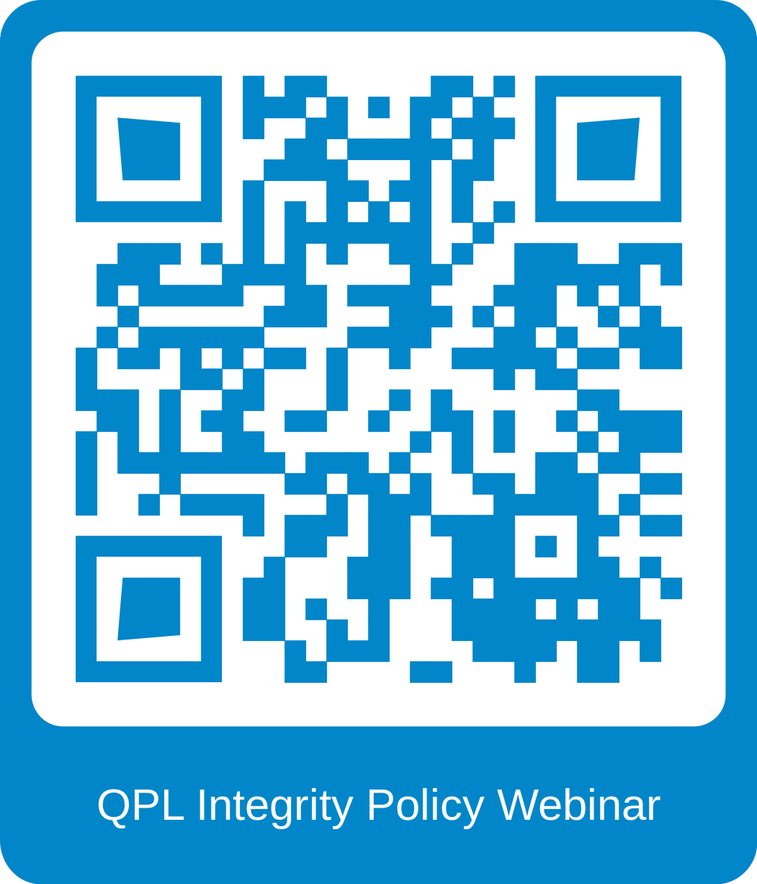
Subscribe & Register!

Slide 58
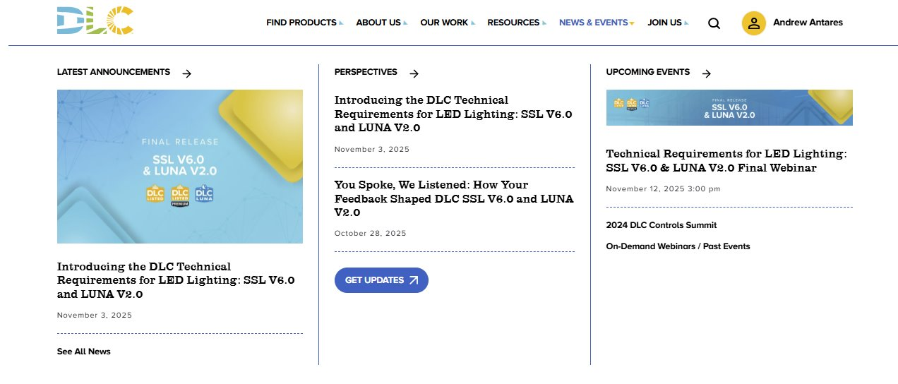
Thank you for attending!
The webinar will be available online later this week
1
2
Notes:
Thank you for attending today. Today's webinar will be posted online by the end of the week in our On-Demand Webinar Section.

