Slide 1
LED Saturation
July 22, 2025
Date
Notes:
Welcome
Good afternoon, everyone!
Welcome to the LED Saturation session.
We’re glad you could join us today. The discussion today promess to provide strategic approaches to navigating the evolving landscape, especially as LED saturation accelerates.
Let’s take just a moment to allow others to join.
While we wait, I’ll go ahead and walk us through the agenda so you know what to expect from today’s session.
NEXT

Slide 2
Agenda
Welcome
Program Planning Working Group (PPWG) Overview
LightingPLUS Market Characterization
Q&A
DLC LED Cost Effectiveness Analysis Tool
Notes:
We have an exciting agenda lined up for today!
We'll begin with a brief overview of the Program Planning Working Group, since today’s session was organized based on interest from members participating in the group. It’s great to see that input turn into a focused discussion like this one.
Dan Mellinger, from Energy Futures Group, is an active member of the working group and has been helping guide the conversations throughout the different sessions.
We are pleased to welcome Geoffrey Cooper, Principal Consultant at DNV, who will walk us through the findings from the LightingPlus Market Characterization report. He’ll share insights into current lighting opportunities and strategies for moving the market forward.
Following that, we’ll open up the floor for a Q&A session, so you can share your thoughts and ask questions.
To wrap things up, Dan will demonstrate how to use the DLC LED Cost-Effectiveness Analysis Tool, which is available for all members, and designed to support your planning and decision making efforts
To get us started, I’ll go ahead and pass the floor to Dan Mellinger, who’s been helping lead the conversations within the Program Planning Working Group and will help guide us through today’s session.
Dan, over to you!

Slide 3

Program Planning Working Group
The Program Planning Working Group serves as a dedicated platform for DLC members (utilities and program administrators) to collaborate on planning and implementation of their energy-efficient lighting and controls programs.
This group provides a forum for facilitated discussions with peer programs:
- on challenges and opportunities
solution development
strategic guidance
Notes:
Thank you Karla.
Since we have a broader audience here today, we wanted to take a minute to introduce the Program Planning Working Group.
The working group was launched earlier this year as a resource for DLC members to collaborate on important and relevant issues related to program planning and implementation
DLC organizes and facilitates the working group, but the topics are directed by members
The PPWG Objectives are:
To facilitate discussions with peer programs to address challenges and explore opportunities.
To drive solution development to enhance programs
And to provide strategic guidance for successful program execution.

Slide 4
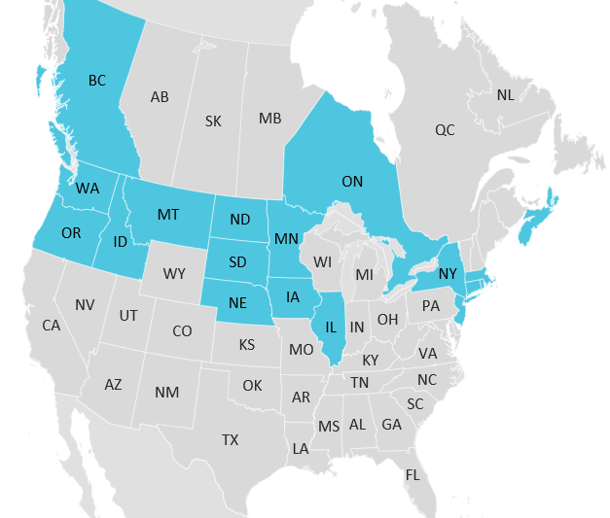

PPWG Membership
Current Membership
  23 individuals
  19 DLC member organizations
  19 states/provinces
Interested in joining?
  Contact Karla Winter
  kwinter@designlights.org
Notes:
Currently the Program Planning Working Group has 23 members spanning 19 different states/provinces
DLC members can join at any time, so if this group sounds interesting to you, please contact Karla Winter.

Slide 5
LightingPLUS Market Characterization
Notes:
Our primary topic today is a special presentation of the LightingPLUS Market Characterization by Geoff Cooper.
Geoff is a Principal Consultant at DNV specializing in examining energy savings potential and how market structure and program interventions influence program results.
In his current role, he oversees a team of market researchers and equity specialists who work with clients around the country to help them solve complex challenges.
Geoff, thanks so much for being here today. I'm going to hand over slide control to you and you can take it away.

Slide 6
LightingPLUS Market Characterization
A Joint Program Administrator Study
Presentation to the DesignLights Consortium

Slide 7

Setting the stage
LED NextGen Technologies
Higher-efficacy products LED to LED
Core study objectives
Advanced lighting controls (ALC)
Redesign LED to LED retrofit
Characterize the remaining commercial legacy lighting stock still available for LED replacement through 2030
Assess the viability and potential savings of next-generation (NextGen) opportunities for LED products
Demand management with lighting
Germicidal UV (GUV)
Tunable lighting

Slide 8
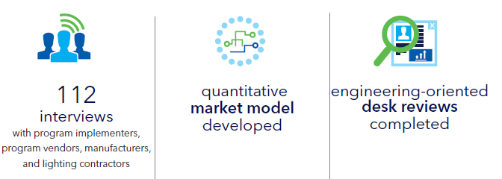
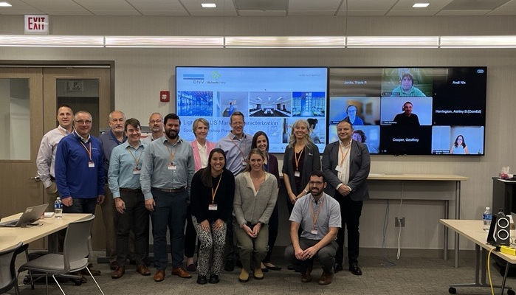
Methodology
Study Sponsor Workshop
17 program administrators, implementation vendors
10 LED and controls manufacturers
85 program participating contractors
The workshop served as a forum for study participants to discuss the status of the market in each jurisdiction and innovate on what solutions may enable PAs to maximize savings in a quickly changing market.

Slide 9
National saturation of linear LEDs is approximately 66%
Saturation: % of LED fixtures installed across the market
We estimate the national saturation of LEDs will be approximately 66% in 2025.
This is likely to differ across jurisdictions due to rates of program interventions and socioeconomic drivers.
High Scenario
Medium Scenario
Jurisdictional differences
Low Scenario
Medium Scenario = National Average

Slide 10
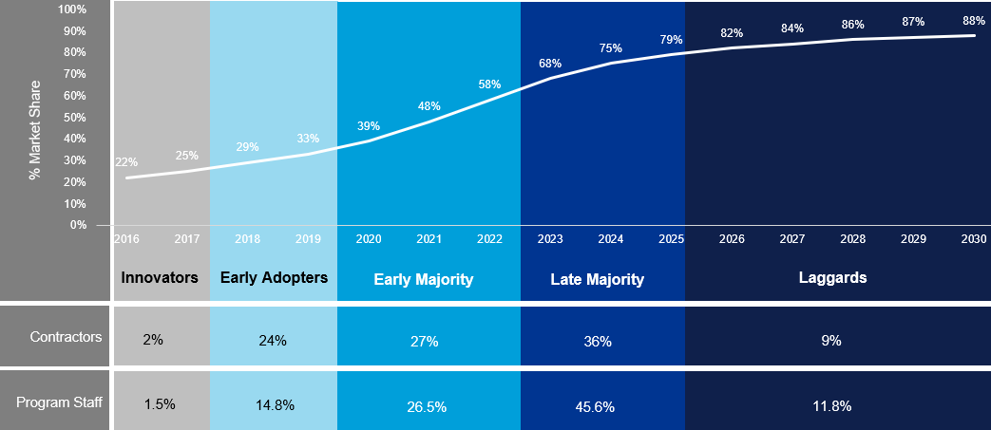
LEDs are entering the Late Majority stage of adoption
A diffusion curve helps explain how, why, and at what rate a technology spreads through a population. A technology reaches critical mass at the point between early and late majority.
Who’s Left to Adopt LEDs?
Late Majority: Risk-averse and only adopts new technology to avoid being “left behind.” Change is unsettling to this group, so they look for high levels of support and standards certification.
Laggards: Value traditional methods of doing things and refuse to adopt a new technology until they are forced to through obsolescence of their former system

Slide 11
LED fixture sales peaked in 2024
Luminaires dominate the market
Sales peaked in 2024 and will slowly decline due to long lifetime hours, leading to less frequent replacement. By 2030, most LED sales will be replacing LED burnouts
TLED sales have been replaced by LED luminaires as the dominant LED technology.

Slide 12
Tapping the remaining opportunity
Where are current lighting projects?
Where contractors see opportunity
  New construction– Contractors reported about half of their work is in new construction or major renovation projects
  Small business – 43% of contractors completed projects in buildings >10,000 sq ft
  Underserved communities – Only 26% of contractors regularly work in underserved communities
  Small businesses – 89% said this comprises the largest proportion of the remaining opportunity
  Specific sectors – Opportunities remain in warehouses, offices, religious organizations, and schools.
  Retrofit – 80% of the remaining opportunities are in retrofits.
“Focus on underserved communities. Programs aren't in tune with those audiences. Lighting is done in nicer areas because they can pay for it. It's not necessarily the money, but the budget. Programs aren't flawed, but distribution of the budget is flawed.”

Slide 13
Contractors see barriers and opportunities
Barrier 1: Financial Factors |  |  |  | Barrier 2: Product Perceptions
Cost (36%) | Access to Capital (16%) |  |  | Awareness (31%) | Resistance to change (25%)
Proposed Solutions |  |  |  | Proposed Solutions
Increase Incentives (30%) | Improve program processes to reduce burden (25%) | Financing Options (22%) |  | Marketing and Outreach (35%)
 | Streamline the application process Simplify program calculations Provide a contact to help with program processes Provide training for trade allies in sales and marketing, outreach, and rebate processing | On-bill financing Low-interest financing |  | Increase marketing and outreach to boost awareness and understanding of technology Include case studies highlighting measurable success

Slide 14

Recommendation: minimize stranded savings
Maximize the quality, efficacy, and functionality of LEDs for customers that are looking to install LEDs.
Each customer touch should maximize savings by installing quality, most-efficient, and functional products
High cost of customer acquisition, especially when the remaining legacy products are at harder-to-reach customer sites
Increase customer satisfaction and minimize stranded savings.
Structuring around savings tiers in a midstream program and better screening downstream customers are ways to optimize.
Minimizing stranded savings by promoting higher quality and efficiency products can be in tension with cost-effectiveness.
Program designers need to consider the trade-offs when promoting these products which will maximize the savings per customer touch but may reduce the number of participants and increase costs.

Slide 15
Recommendation: target market laggards
Target hard-to-reach segments of the market and other market laggards.
Offering higher incentives for hard-to-reach segments will increase contractor interest.
Seventy-four percent of contractors said they do not pursue projects in hard-to-reach or underserved market segments
Smaller customers frequently have fewer resources and/or are located in areas without a strong contractor base (e.g., inner city, rural)
Narrowly focused and short-term outreach campaigns can target a specific location.
A direct-install model might best help convert hard-to-reach legacy systems
This model can cost three to five times more than a rebate program however

Slide 16

Assessing NextGen Opportunities
DNV evaluated six NextGen opportunities as part of this study. Each opportunity received a grade indicating its potential fit for generating savings through a traditional program model.
Mass Market Opportunities:
Higher-efficacy products LED to LED – A
Advanced lighting controls – B
Redesign LED to LED retrofit – C
Niche Opportunities
Demand management with lighting – C
Germicidal UV – D
Tunable lighting – D

Slide 17
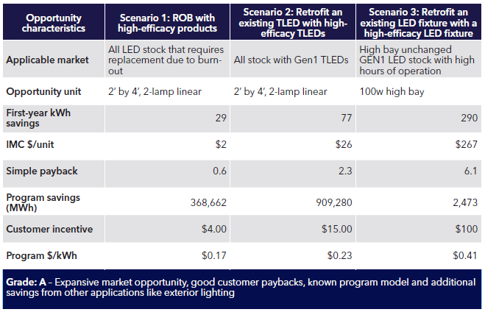
Higher-efficacy products LED to LED
This opportunity leverages the range in LED efficacy (lumens per watt) offered in the market.
Data shows a sustainable 20% savings trend between baseline and highest efficacy products.
Why a Grade of A?
Incremental cost differential is negligible (except retrofit)
Good customer payback
There is a large addressable market
Opportunities within midstream and downstream programs
Notes:
Manufacturer: “I think [this NextGen opportunity] will be a repeat of 2008–2012. New construction is down for every manufacturer; retrofits are where the opportunity lies. There’s a ton of early LEDs that need to be replaced. Can’t think of a single manufacturer that had a product that will still be doing what it should. Opportunities for first and second generation we’re seeing are huge.”

Slide 18
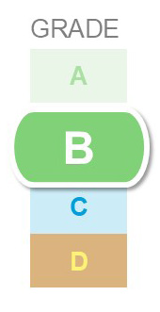
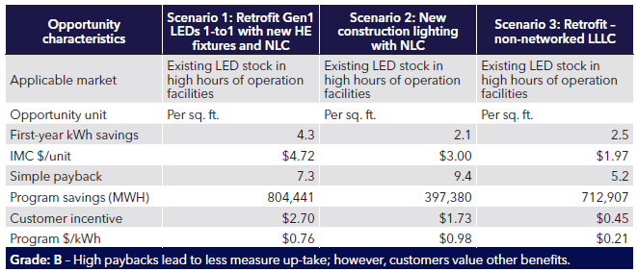
Advanced lighting controls
Advanced lighting controls (ALC) are defined in this study as networked lighting controls (NLC) at the fixture or zone level with centralized access or NLC.
Luminaire-level lighting controls (LLLC) with integrated sensors are an attractive option for smaller buildings.
Why a Grade of B?
System features are evolving
Savings potential is high, but cost-effectiveness requires long hours of operation
NLCs favor larger buildings, non-networked LLLCs are an option for smaller buildings
Commissioning is critical
Stacking benefits

Slide 19
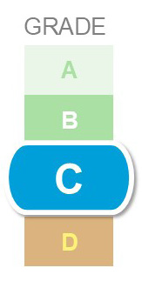
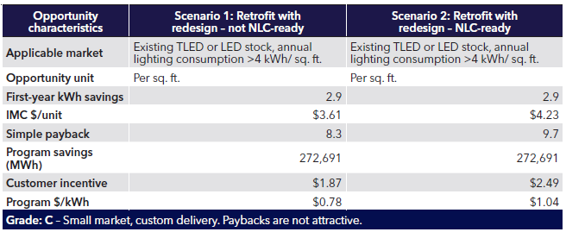
Redesign LED-to-LED retrofit
This opportunity requires traditional design methods conducted by a lighting designer
Implementation typically requires modifying the existing ceiling grid, additional power wiring, and design services, which is a much more labor- and skill-based scope than one-for-one replacements.
Why a Grade of C?
Redesign leverages superior lighting distribution of LEDNLCs favor larger buildings
Lighting design is inherently a custom process
Control-ready fixtures add to costs

Slide 20
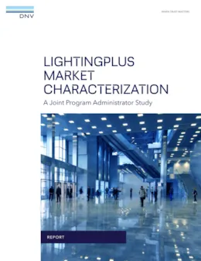

Wrap-up and Q&A
Want to be a part of the next joint study?
DATA CENTERS!!!
https://www.dnv.com/publications/lightingplus-market-characterization/

Slide 21
Geoffrey Cooper, Director of Energy Markets
geoffrey.cooper@dnv.com

Slide 22
LED Cost Effectiveness Analysis Tool
Notes:
The LED Cost Effectiveness Analysis Tool was original developed in 2019, based on member interest.
Several members were interested in exploring customer economics and utility rebate cost when replacing early generation LED with current LED + NLC. Exactly the strategy that Geoff just described.
The tool can also be helpful in areas where LED has become baseline, for reasons such as saturation or in states that have enacted mercury bans.
We updated the tool in 2024 to use more current product costs, efficacy, and electric rates.

Slide 23
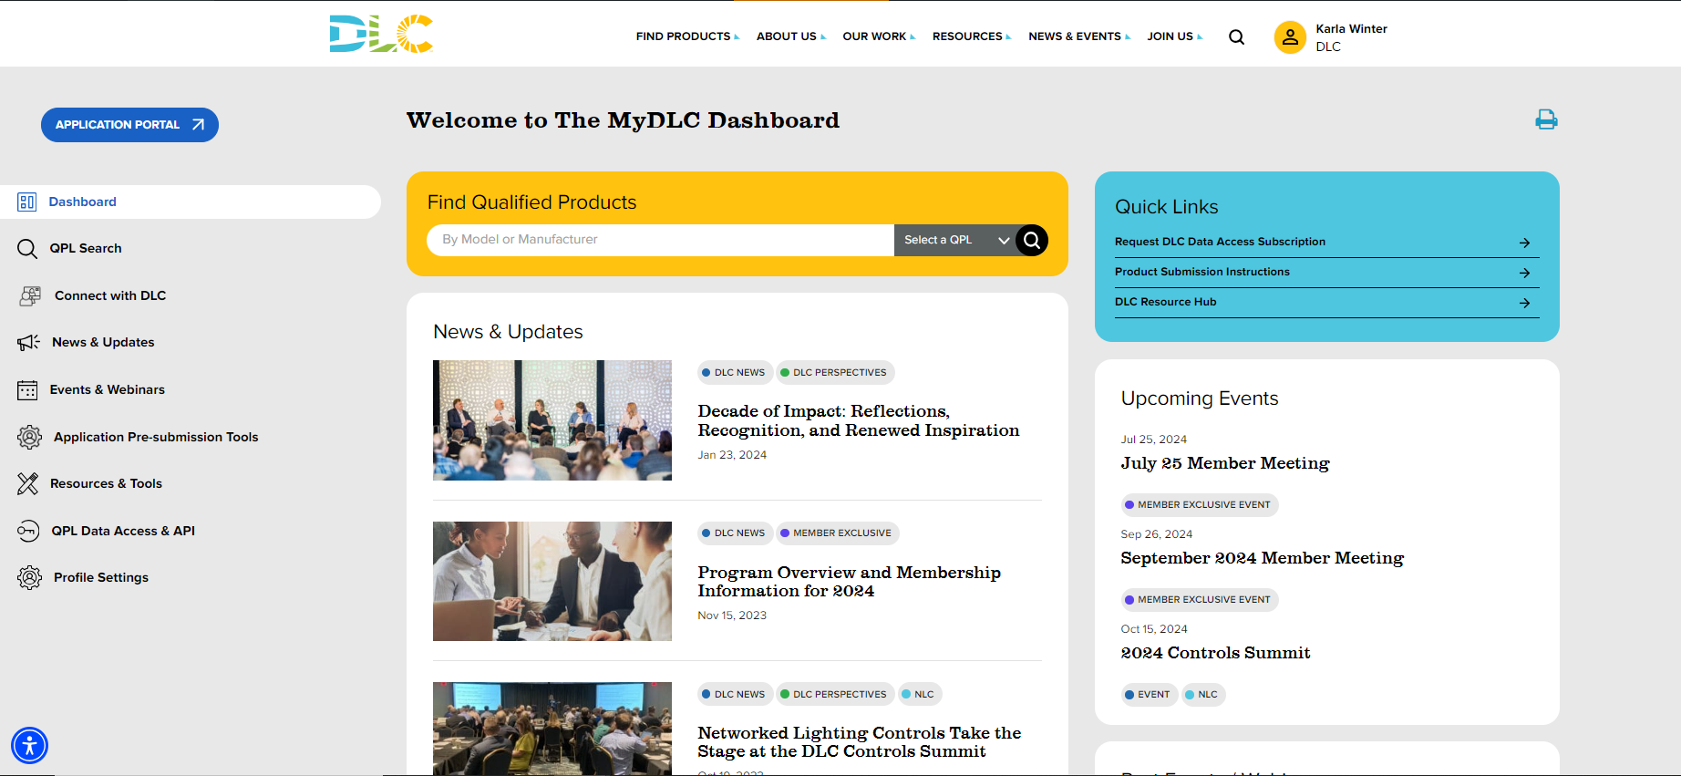
DLC Dashboard → Member Login
Notes:
Before I show you the tool, I want to make sure you all can find it.
You may want to download the tool and play with it as I go through my demo.
First, you'll need to login to your DLC dashboard.

Slide 24
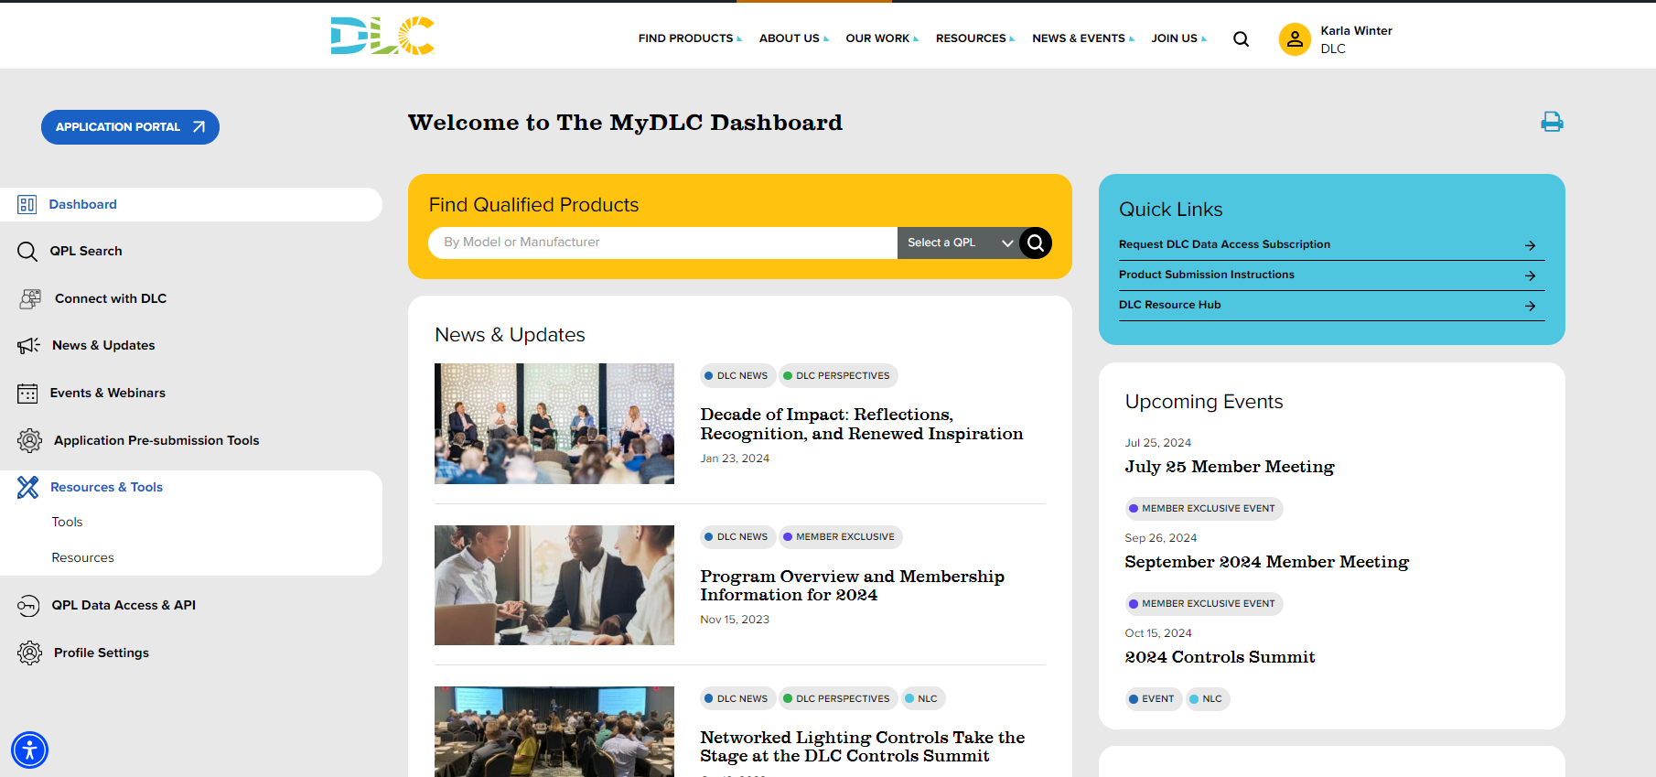

Dashboard → Resources & Tools → Tools
Notes:
Once you're logged in, you'll need to click on the "Resouces & Tools" menu on the left hand side, and then on the "Tools" option.

Slide 25
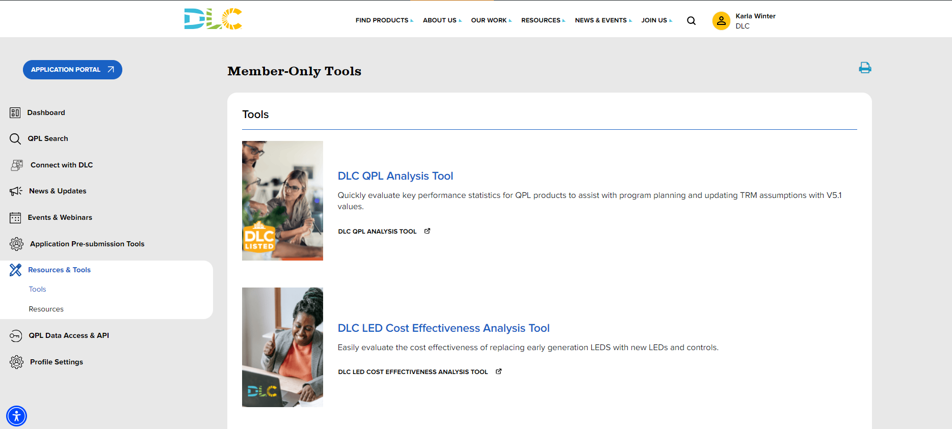

DLC LED Cost Effectiveness Analysis Tool
Notes:
Finally, click on the download link for the DLC LED Cost Effectiveness Analysis Tool

Slide 26
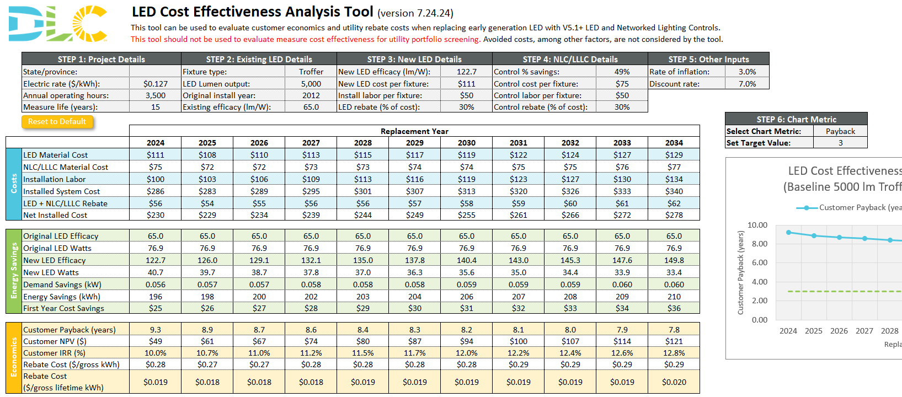
DLC LED Cost Effectiveness Analysis Tool
Notes:
The tool built in Excel, and it relies on macros. So, when you first open the file, make sure to click the button to allow macro content.
I'm going to switch over to the tool for a live demo.

Slide 27

Next Steps
Please participate in the survey on adapting to mercury bans / other regulations
Meeting schedule:
✓ | Kickoff & Topic Planning | Mar 6
✓ | NLC Implementation | Apr 24
✓ | NLC/LLLC Market Engagement | Jun 26
→ | LED Saturation | Jul 22
 | Reaching Small Businesses | Sep 4
 | LLLC Implementation | Oct 30
 | Annual Review & Recap | Dec 11
Notes:
Thank you all for participating today!
We still have a survey open on how programs are adapting to mercury bans and other regulations that affect LED lighting. If you haven't already, please participate.
Our next working group meeting is on September 4, when we'll be discussing strategies to reach small business.
Karla, do you have any final thoughts you want to share?

Slide 28
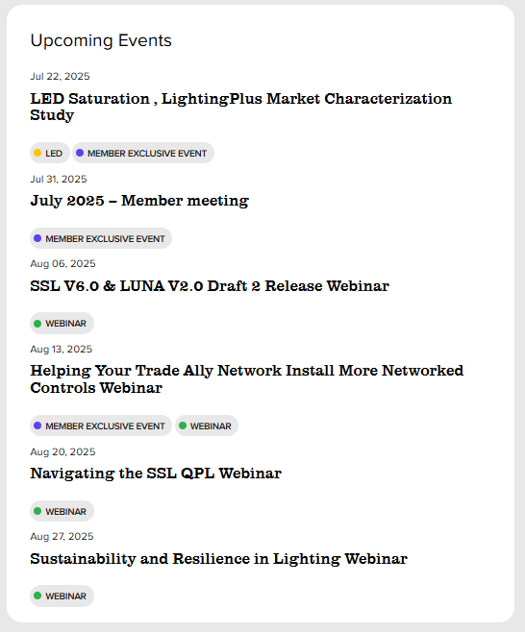
Upcoming webinars:

Slide 29
Thank you for your participation !
We appreciate your time & contributions.
Stay connected: Teams group chat or
Contact: Karla Winter

