Slide 1
Reaching Small Business
September 4, 2025
Notes:
Good afternoon Everyone:
Welcome to the Session #5 of the Program Planning working group
Today we will be discussing “Reaching Small Business” topic
We will record the meeting just for note taking purposes, it will not be posted online.
And special request, Please if you are able, turn on your camera or at least during the discussion we would love to see you.
NEXT

Slide 2
Agenda
Welcome
Reaching Small Business:
DLC Small Business Resources
Next Steps
Focus on Energy, Business Portfolio Manager – Leah Maggio
Open Discussion & Identify Best Practices
National Grid, Customer Energy Management – Zachary Lippert
Notes:
We have a great agenda lined up for today.
To start, Dan will provide an update of the resource that compiles program strategies to address regulations such as mercury bans,
You may remember the survey you participated in — that input was key in building the resource that will be available to all of you.
After that, we’ll move into a discussion focused on small business programs.
We are excited to welcome Leah Maggio from Focus on Energy and Zachary Lippert of National Grid
They’ll be sharing strategies and insights on how their programs are supporting small businesses.
Next, Jason will walk us through DLC resources that can help support business programs
And finally, we’ll close with our next steps and what to expect in upcoming sessions.
NEXT

Slide 3
Mercury/Regulations Survey
Notes:
Before we dive into today’s topic, I wanted to give a quick update on the mercury ban / regulations survey
The survey is completed with 14 detailed responses from programs
79% of respondents live in a state that has an active or pending mercury ban.
Nearly 40% of respondents have implemented or have plans to implement changes in response to a mercury ban; 20 more are looking for ideas
Similar number of programs are adapting to state or commission rules.
The top strategies that have been implemented include expanding control offerings, eliminating lamp incentives, and increasing incentives for controls
There will be more to come, including qualitative findings!

Slide 4
Today’s Topic
Why small businesses?
They represent 90% of US businesses and consume about 20% of US energy, but they attract less than 4% of utility energy efficiency spending. (EnergySavvy)
They occupy more than 20 billion square feet, representing more than 30% of all commercial space. (ACEEE)
89% of contractors said the largest proportion of the remaining (lighting) opportunity is with small businesses. (DNV LightingPLUS)
Small businesses are hard, but not impossible, to reach!
Notes:
Okay, onto our topic today: Reaching Small Businesses
We’re covering this topic since it was highly ranked by you all earlier this year. The statistics shown here support the ranking and emphasis.
Small businesses are everywhere; they consumer a lot of energy, but they are underinvested in by EE programs. According to EnergySaving, small business attract only 4% of utility EE spending!
In terms of lighting, much of the remaining lighting opportunity exists within small businesses. DNV’s LightingPLUS report indicated that 90% of contractors believe most of the remaining opportunity is with small businesses.
And we know that small businesses are hard to reach, but it’s not impossible. Today we’ll hear from two programs on how they approach these customers.
With that, I’m going to turn the

Slide 5
Reaching Small Businesses
DLC Program Planning Working Group
September 4, 2025

Slide 6
Areas of Focus
Traditional Energy Efficiency
Decarbonization
Equity

Slide 7
Threshold for Small vs. Large Commercial
Small Business
Electric annual usage
≤1.5 million kWh
Gas annual usage
≤40,000 therms
Large Commercial
Electric annual usage
>1.5 million kWh
Gas annual usage
>40,000 therms

Slide 8




Small Business Turnkey Process
Small businesses visit the Mass Save website* to identify their Program Sponsor
Small businesses contact their Program Sponsor to schedule an energy assessment
The turnkey vendor performs a no-cost assessment, and the business gets a detailed report (as a follow up after the visit) of all the ways they can save energy
Energy savings measures chosen by the customer are installed by our qualified vendor or their subcontractors
* MassSave.com/SmallBusiness

Slide 9
Small Business Turnkey Offering
The PAs strive for comprehensive projects capturing all available EE and electrification opportunities. Incentives available for these measures and financing may be available depending on PA.
Lighting & Controls
HVAC - Heat Pumps³
Building Controls
Weatherization³
Refrigeration
Hot Water Reduction
Process
Any other opportunities found
Category | Offer¹
Standard Small Business | Up to 70% of Project Cost
Main Streets | Up to 90% of Project Cost
Small Business Renters² | Up to 100% of Project Cost
Small Non-Profits² | Up to 100% of Project Cost
Uncontrolled Lighting² | Less than 70% - Varies by PA
All offers have a limit on the cost of savings, so not all projects are funded at the percentages shown here.
New for 2025-2027.
Heat pumps and prescriptive weatherization have a separate incentive structures that align with the large C&I offerings.

Slide 10

Small Business Outreach Efforts
General Marketing
Statewide marketing
Program administrator marketing
Vendor marketing
Targeted Marketing
Case Studies
Spotlight on Small Business videos
Main Streets events
Community First Partnership
Language access efforts
Industry organization partnerships
Cold calls
Trade ally engagement

Slide 12

Commercial Weatherization
Available Weatherization Measures
Building Insulation (wall, attic, basement)
Building Air Sealing
Weather Stripping
Recent Changes
Pre-weatherization barrier mitigation incentives for knob & tube and vermiculite/asbestos remediation
Available to customers through Turnkey or Applications/CDO
More info at MassSave.com/ciwx

Slide 13
Commercial Heat Pump Rebates - applications
Equipment Type | Efficiency Requirement | Rebate Amount
Air Source Heat Pumps | Refer to MassSave.com/CIHPQPL | $2,500 per ton*
Air Source Variable Refrigerant Flow (VRF) |  | $3,500 per ton*
Ground Source Heat Pumps |  | $4,500 per ton*
*Tons calculated based on AHRI cooling capacity divided 12,000 BTUs. (1 ton = 12,000 BTUs). NOTE: Projects exceeding 150 tons in total require pre-approval for Cape Light Compact, Eversource and National Grid customers, and all projects require pre-approval for Berkshire Gas, Liberty Utilities and Unitil customers
Notes:
The Sponsors of Mass Save offer incentives for commercially metered facilities to install energy efficiency and electrification equipment. In the spirit of building electrification, various levels of generous rebates are available for different heat pumps, As shown on this slide.

Slide 14
Small Businesses: Q&A
Program Design: How has your small business lighting program/outreach evolved over time?
Customer Engagement: What strategies have been most effective in reaching small business customers?
Implementation: What delivery models have worked best for small businesses (direct install, distributor/instant rebate, trade ally-driven)?
Incentive Design: How have incentive levels influenced adoption of LEDs and controls?
NLC and LLLC: Do you offer incentives on NLC and/or LLLC through your small business program?
Equity & Access: How do you ensure the program reaches diverse and underserved small businesses?
Lessons Learned: What has been your biggest success in getting small businesses to adopt lighting and controls?

Slide 15
DLC Small Business Resources

Slide 16
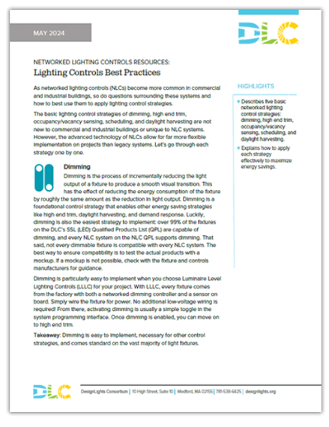

Controls Best Practices
Lighting Controls Best Practices

Slide 17
SSL V6.0 - Controls Categories
Category | Name | Notes
1 | No Integral Controls
2 | Controls Ready Product | Integral Receptacle
3 | Product with One Integral Sensor Function | Non-Networked
4 | Product with Two or More Integral Sensor Functions | Non-Networked
5 | Product with Networked Controller | NLC QPL Listed
6 | Product with Networked Controller and Two or More Integral Sensor Functions (LLLC) | NLC QPL Listed
Notes:
In draft 1, we had separate controls categories for indoor and outdoor products. For draft 2, we combined the controls categories into one list for all products.

Slide 18
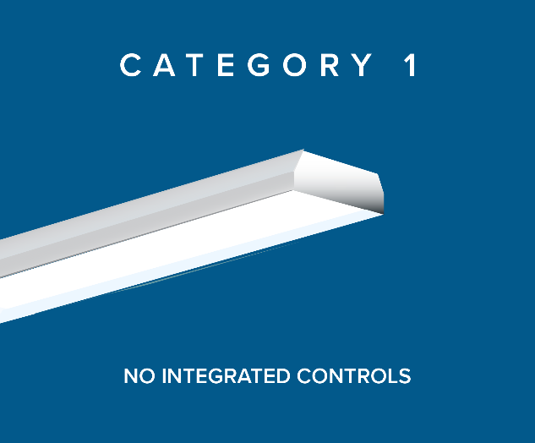
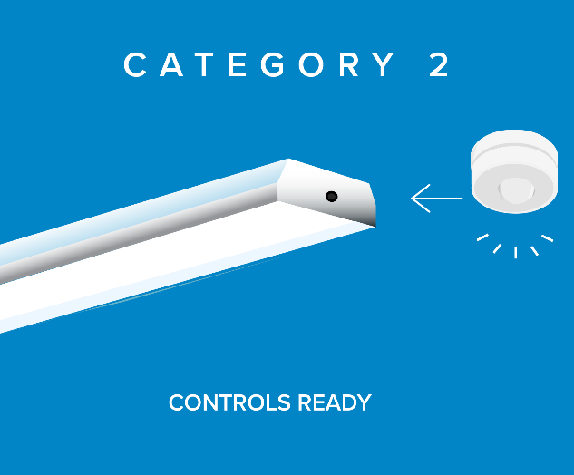
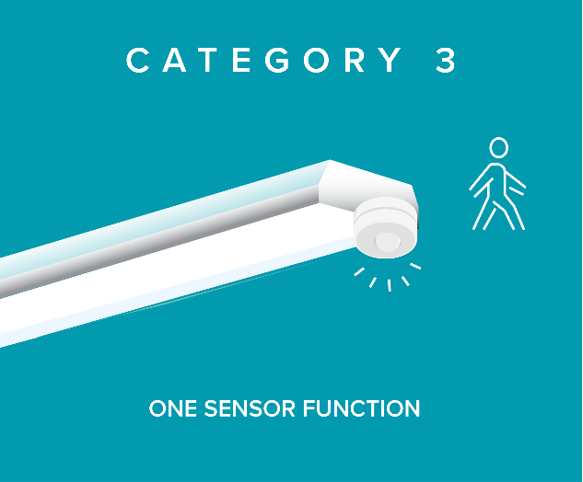
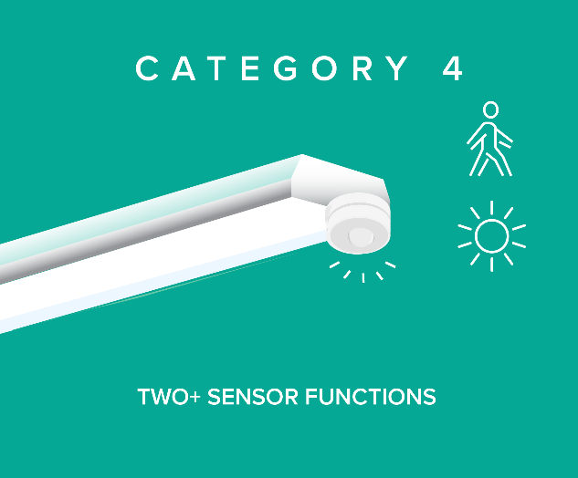
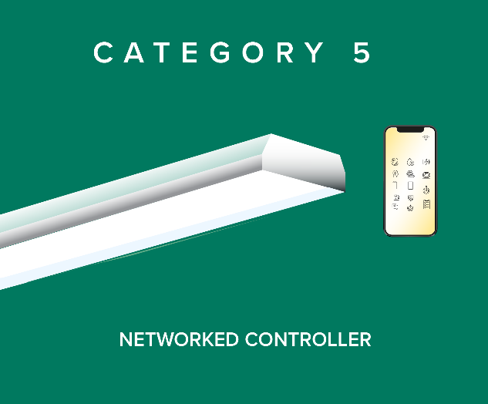
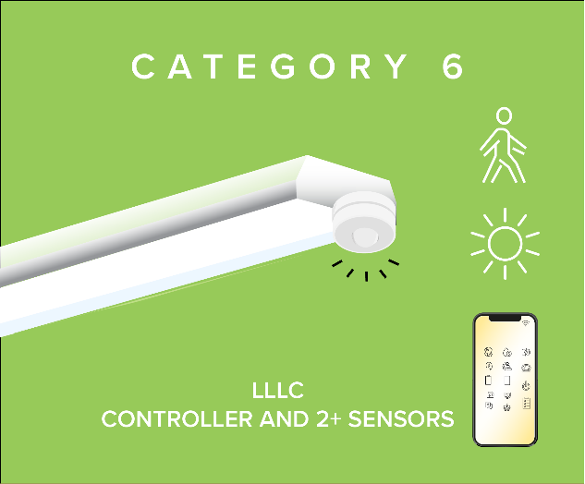
Controls Categories
Notes:
We have also introduced some graphics to help stakeholders better understand the controls categories. Category 1.....

Slide 19

Controls Categories enable larger savings
5- NLC
4- Two Sensor Functions
6- LLLC
2- Controls Ready
3- One Sensor Function
1- No Integral Controls
Notes:
Controls categories enable larger energy savings by helping you align your incentive structure systematically with controls options. A luminaire without integral controls saves no additional energy beyond its designed efficacy. A controls ready luminaire may save more energy if additional sensors are installed at a later date. A two function sensro will save more energy on average than a one function sensor. A luminaire with an NL will save more energy on average than a luminaire that only has sensors. And a luminaire with an LLLC and NLC will save the most energy on average.

Slide 20

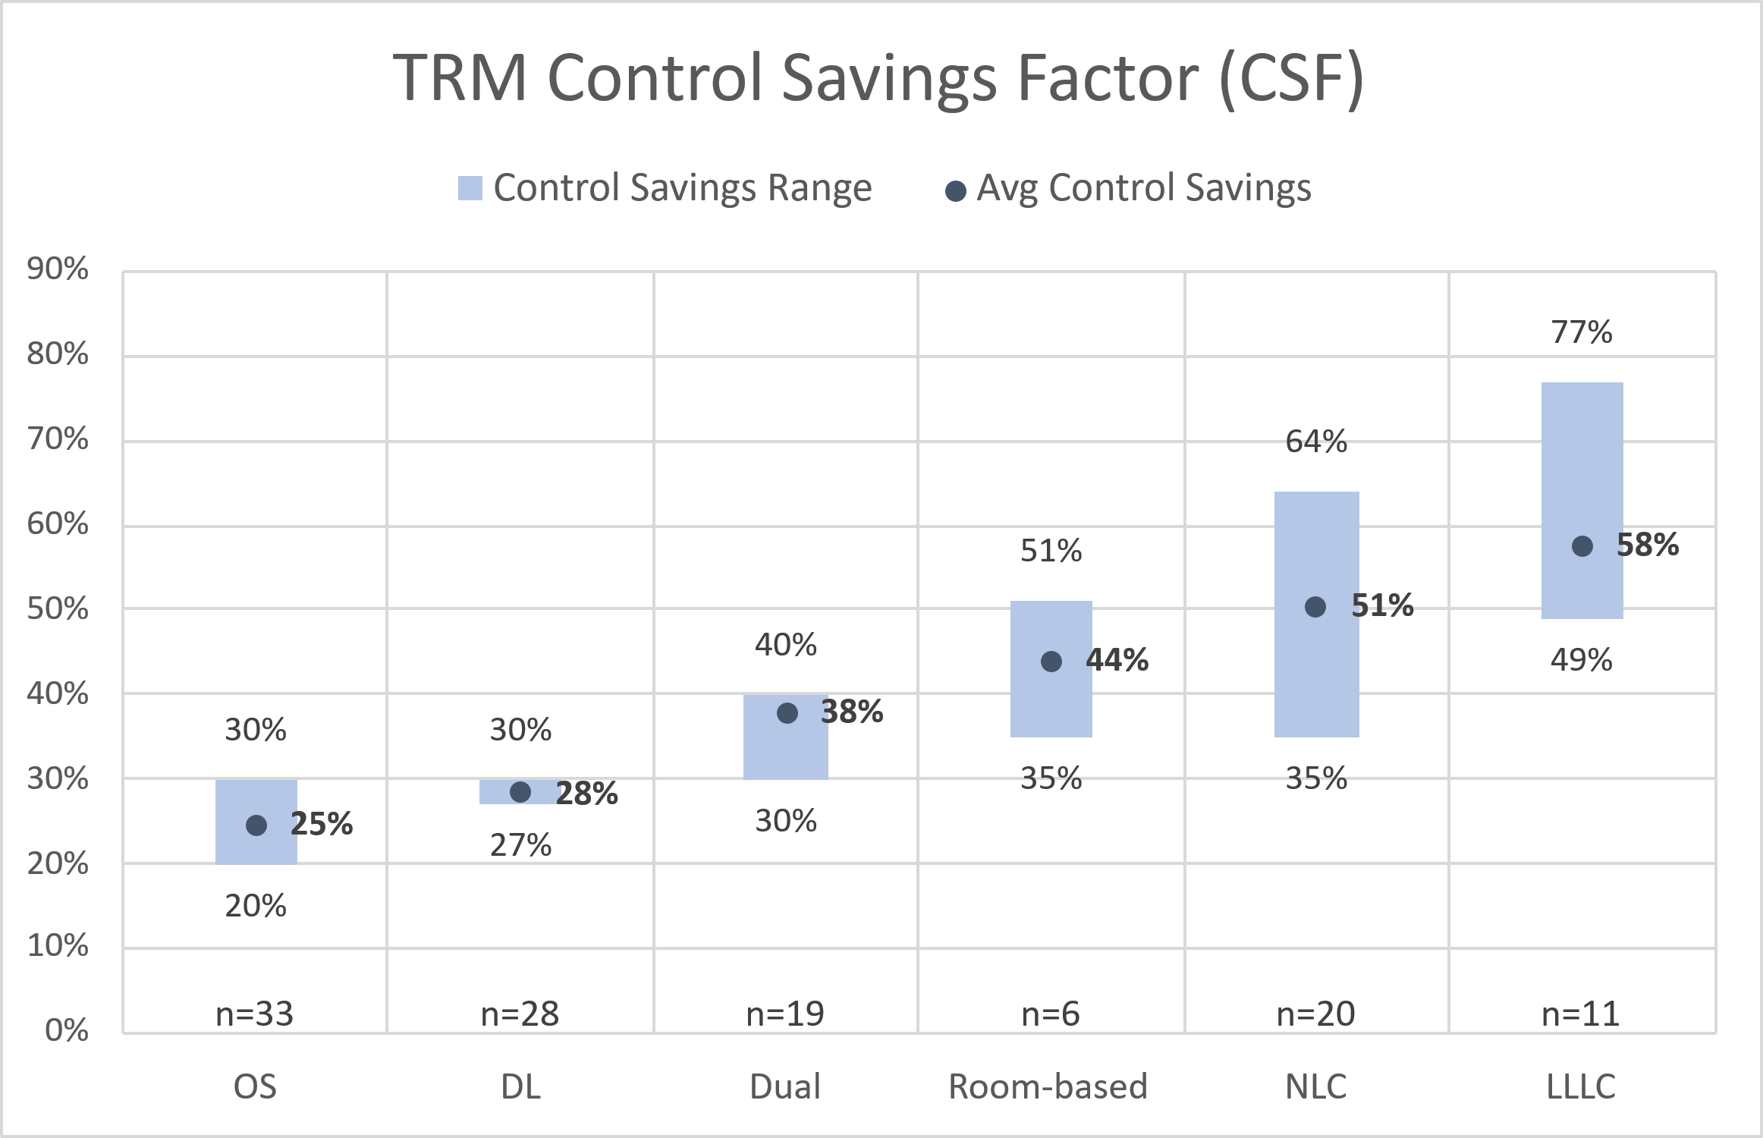
Control Savings Factor (CSF)
CSF defines the % savings off the controlled load, due to the use of controls
Controls Category:
3
3
4
3 or 4
5
6
Notes:
For any control measure, one of the most important assumptions is control savings factor.
This value defines the % savings resulting from the use of controls
For example, an occupancy sensor may be assigned 25% savings off the baseline controlled load
The average CSF increases across the control types shown here, including occupancy sensors, daylight sensors, dual occupancy/daylight sensors, room-based controls, NLC and LLLC.
Almost all TRMs have an OS measure, and large number also have daylight sensors.
There is not much variation across TRMs for OS And DL. Most TRMs reference the 2012 LBNL metadata study on lighting control (24% OS, 28% DL).
A growing number of TRMs now include dual sensors (19), which are also often based on the LBNL study for “multiple types” of 38%
While there are a small number of dual sensor measures (6), there’s a notable increase in savings over stand-alone sensors
Some measures are dual + trim, without a networking requirement.
Some TRMs simply use 38% based on LBNL
Most TRMs assume 49% savings for NLC, based on the DLC/NEEA study. As you can see from the range, some TRMs assume very low CSF.
The low end of NLC (35%) is from the Northwest, which defines NLC separately from LLLC.
For LLLC, you can see that most TRMs assign a higher CSF, 58% on average and as high as 77% (Minnesota)
Only 11 TRMs have an explicit LLLC measure; opportunity for more TRMs to differentiate higher savings with LLLC
Room based = multiple control strategies but networking may be non-existent or limited to a single room.

Slide 21
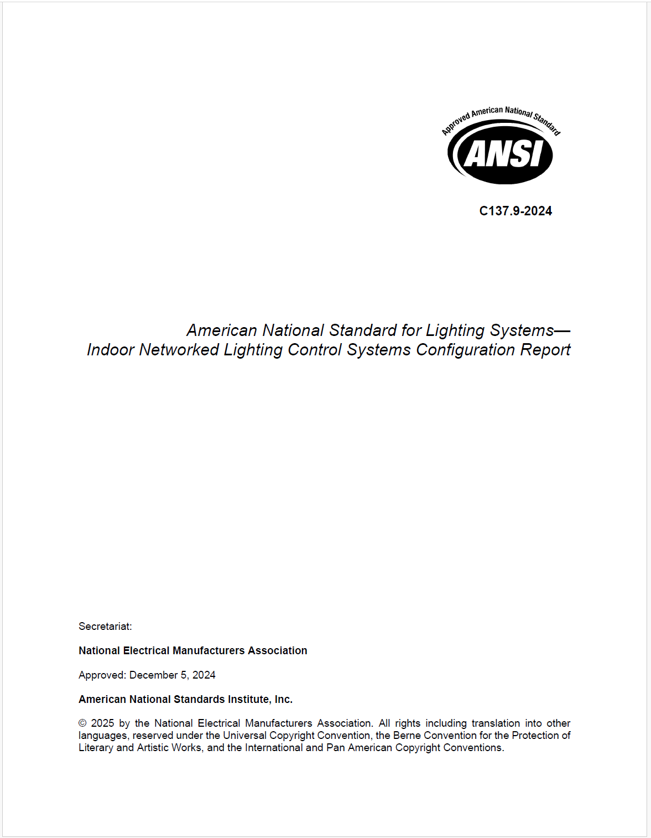
NEMA/ANSI C137.9 Indoor Networked Lighting Control Systems Configuration Report
Approved: December 2024
Published: March 2025

Slide 22

ANSI/NEMA C137.9 Overview:
Written with and for EE Programs – ensure alignment with program needs and goals
Standardized NLC Configuration: Provides high-level overview of NLC configuration settings for a specific installation.
Reporting: Reports generated by the NLC System.
Submission Process: Incentive Applicant then submits PDF reports to EE Programs for review.

Slide 23
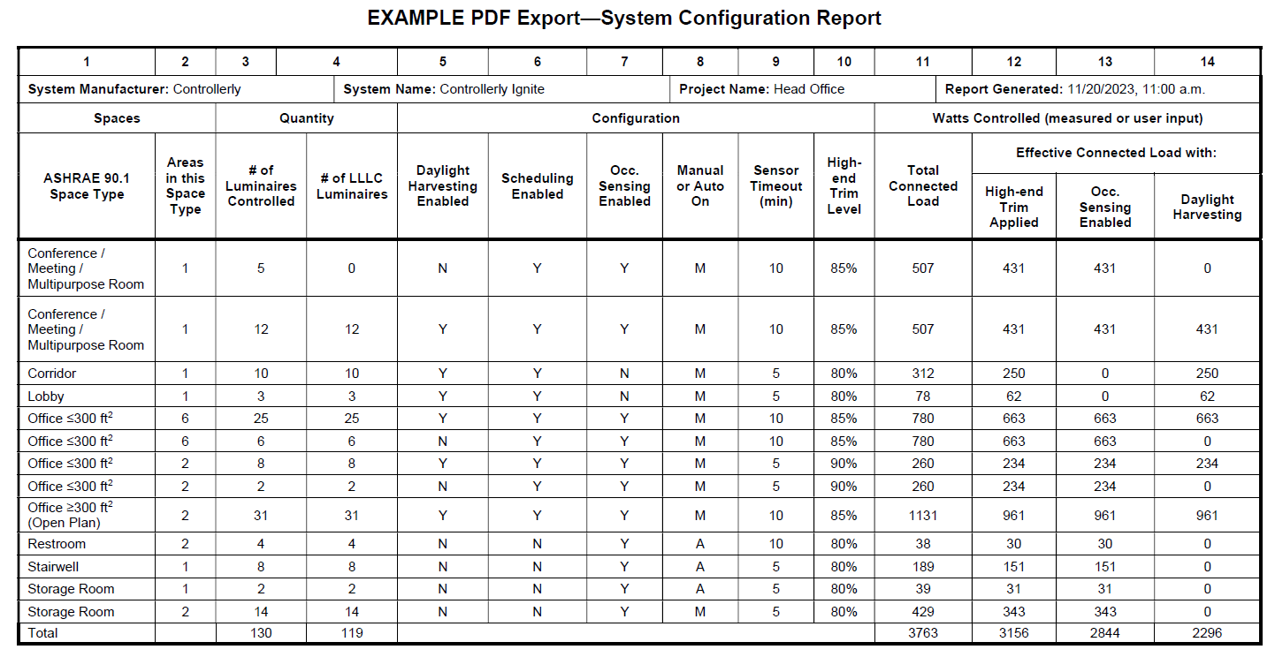
ANSI C137.9 Standard

Slide 24

ANSI/NEMA C137.9 - Next Steps
Demonstrate EE Program Support/Requirements
Add to NLC QPL as 'reported' standard
Engage NLC Manufacturers to add C137.9 support to their systems.
NLC QPL to make compliance 'required reporting'

Slide 25

Next Steps
Upcoming meeting schedule
✓ | Kickoff & Topic Planning | Mar 6
✓ | NLC Implementation | Apr 24
✓ | NLC/LLLC Market Engagement | Jun 26
✓ | LED Saturation | Jul 22
→ | Reaching Small Businesses | Sep 4
 | LLLC Implementation | Oct 30
 | Annual Review & Recap | Dec 11

