Slide 1
LLLC Implementation
October 30, 2025
Notes:
Good afternoon Everyone:
Welcome to the Session #6 of the Program Planning working group. Happy Halloween!
Today we will be discussing “LLLC Implementation” topic
We will record the meeting just for note taking purposes, it will not be posted online.
And special request, Please if you are able, turn on your camera or at least during the discussion we would love to see you.
NEXT

Slide 2
Agenda
Welcome
Next Steps
Ed McGlynn – Senior Manager, Commercial Market Deployment, Efficient Technology Accelerator (ETA)
Topic Introduction
LLLC Implementation
Chris Wolgamott – Principal Product Manager, Technology and Product Management, Northwest Energy Efficiency Alliance (NEEA)
Notes:
•We have a great agenda lined up for today.
To start Dan will provide an overview of today's topic and set the stage for our discussion
After that, we will move into a discussion focused on the LLLC Implementation
We are very excited to welcome our guest speakers:
Ed McGlynn – Senior Manager , Commercial Market Development from Efficient Technology Accelerator Program in Minnesota
And Chris Wolgamott Principal Product Manager Technology and Product Manager from Northwest Energy Efficiency Alliance
Thank you both for joining us today and for sharing your insights on LLLC Implementation
Now , I will turn it over to Dan, Dan please take it away

Slide 3


Happy Halloween!
Notes:
Thank you, Karla. Happy Halloween everyone!
How many of you are planning to dress up in a lighting control costume tomorrow?
I asked Google Gemini and Chat GPT to create a Halloween costume for a lighting control person, and this is what I got. Two very different concepts!

Slide 4
LLLC Implementation
Measure definition
Savings calculation
Incentive design
Project requirements
Data collection
Demonstration projects
Cost effectiveness
Education
NLC/LLLC Market Engagement
NLC Implementation
LLLC Implementation
October 30
June 26
April 24
Notes:
During today’s meeting we will be focusing on LLLC implementation.
This topic ties in closely with two sessions that we had earlier this year, on NLC implementation in April and NLC/LLLC market engagement in June.
We’re fortunate to have two great presenters today, who will share their perspectives and insights on LLLC.

Slide 5
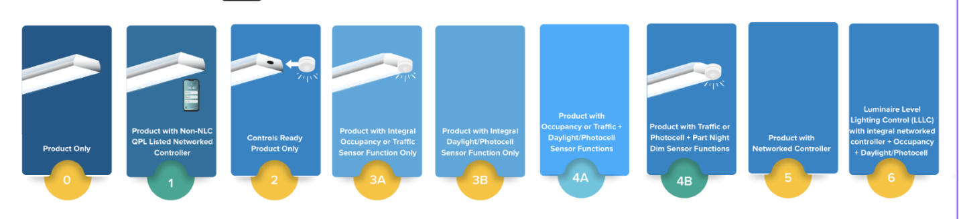
Control Categories in SSL v6.0
Notes:
LLLC implementation also ties in closely with the near final release of the SSL v6.0 technical requirements
If you’ve been following along during the development process, you’ll be aware that “control categories” have been proposed.
These designations are intended to make it easier for specifiers, installers, and utility programs to identify and select controllable products.
All products on the SSL QPL will be assigned a category, based on their control capabilities.
And of course, LLLC is one of these categories (#6 shown here).
We’ll have more to come on this topic in future PPWG meetings!
So, with that into, let’s hear from our presenters. First, we have Ed McGlynn from the Minnesota ETA.

Slide 6
Ed McGlynn
Efficient Technology Accelerator (ETA)

Slide 7
MN ETA – LLLC Initiative
October 30, 2025

Slide 8
MN’s Efficient Technology
Accelerator (ETA)
Accelerating adoption of key energy efficient technologies and approaches, together with:
Investor-owned utilities (funders)
Minnesota Department of Commerce, Division of Energy Resources (administrator)
Center for Energy and Environment (implementer)

Slide 9


The LLLC Initiative
Market transformation focus
Strives to advance the adoption of LLLC systems
Compliments utility efficiency programs
Aims to have LLLC systems become standard practice for commercial buildings in Minnesota

Slide 10
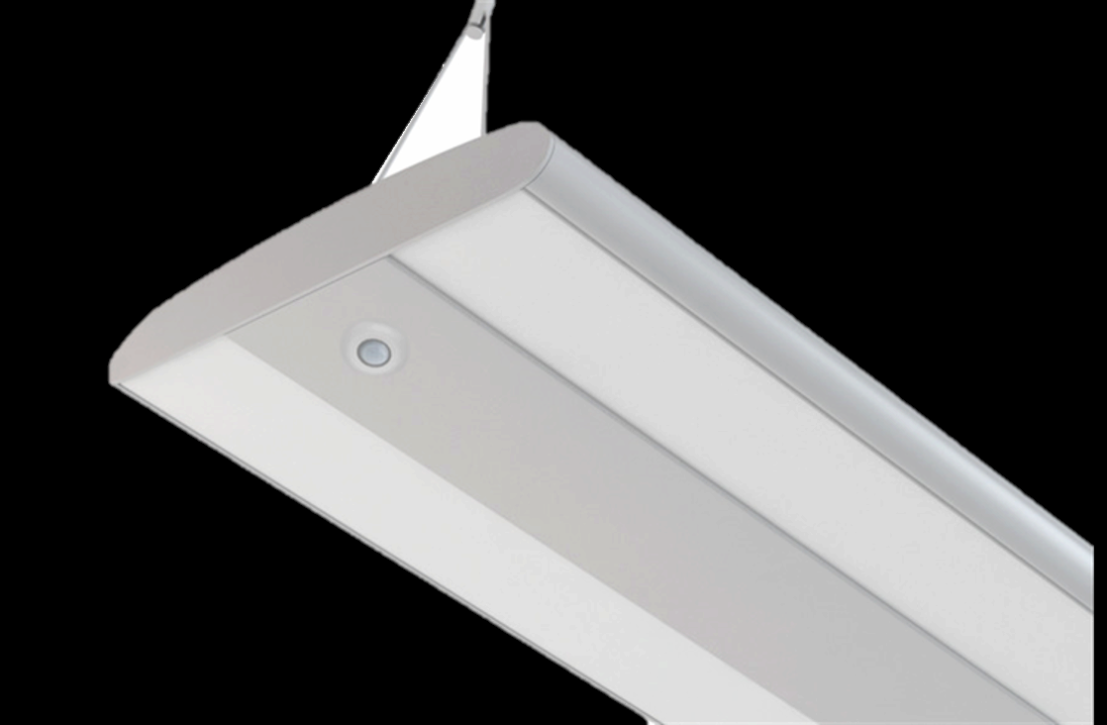
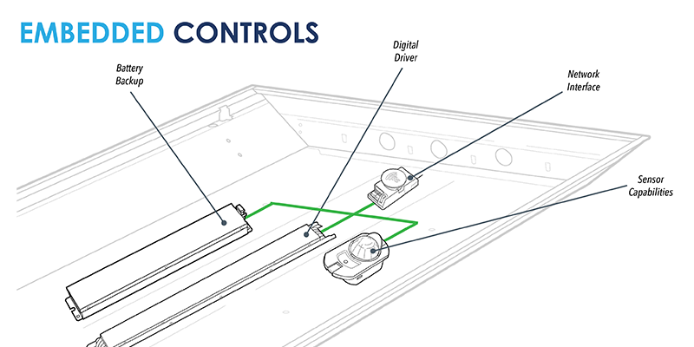

Why Are We Focused on LLLC?
LLLC is where C&I lighting is going
Best path for MN code compliance
Huge untapped potential​
Better customer solution
Average energy savings of ~60%
Selling up on value vs. down on cost
Technical savings potential for Minnesota - 2,490,000 MWh

Slide 11






Market Support Strategies
Conduct pilot projects and promote results
Provide resources and technical support to early adopters
Conduct outreach to market actors to build awareness
Advance codes and code compliance
Collaborate with utilizes and national partners to align offerings
Deliver trainings to increase knowledge and experience

Slide 12

How We’re Different From Utility Programs
Statewide initiative
Focus on behavioral change
Engage upstream and midstream
What we do have: PARTNERS!
NEEA, DOE, and all of you
MN Utilities
Product Champions
National experts
We do not offer incentives
We do not have “customers”
We do not have access to “trade ally networks”

Slide 13
Progress and Looking Ahead

Slide 14
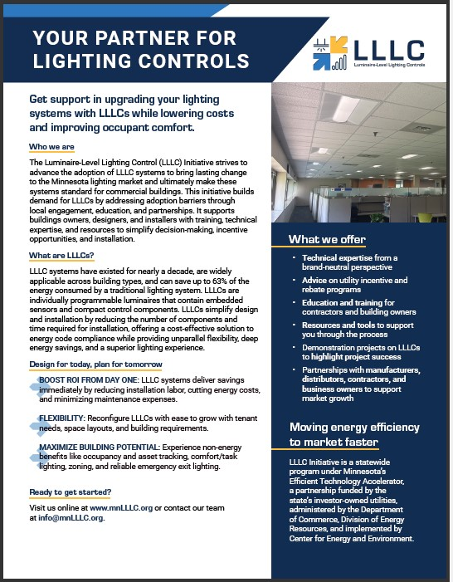
2024 Recap
Focused efforts on new construction market
Developed foundation resources
Market actor engagement
Completed first 2 demonstration projects
Completed 4 contractor trainings
Participating in networking/industry events

Slide 15
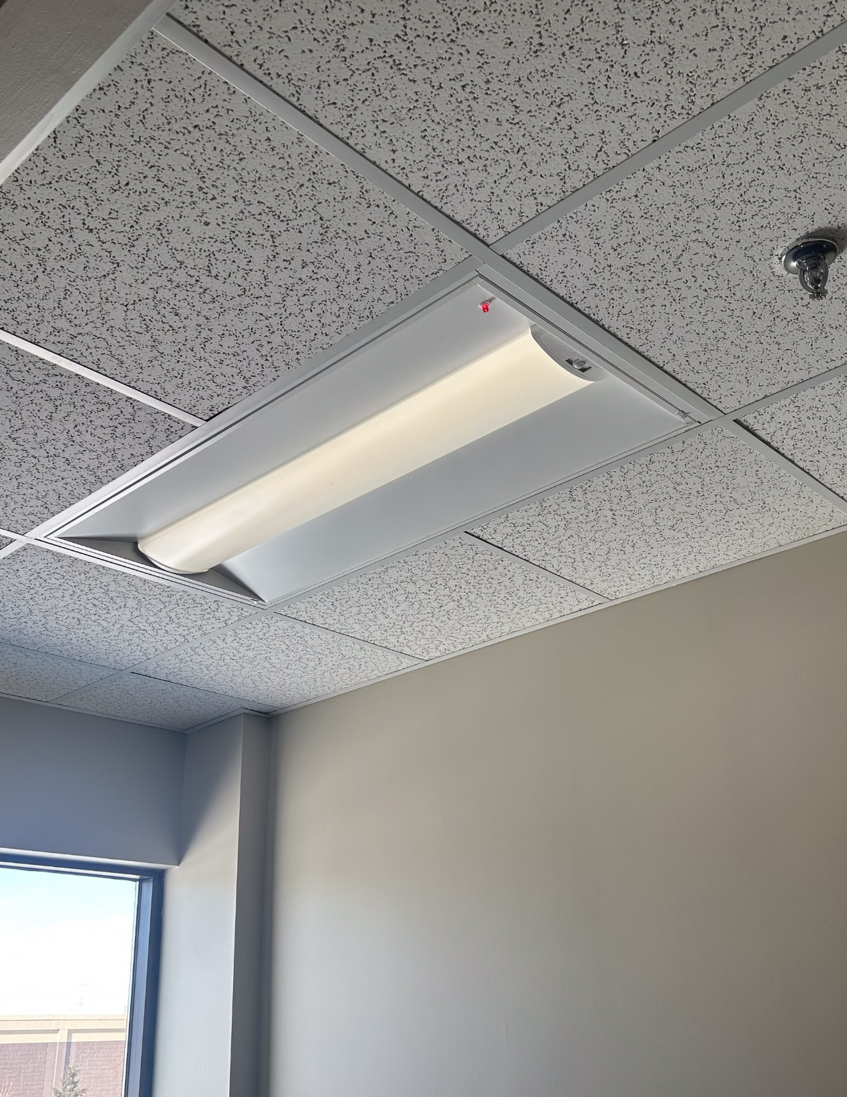
2025 Focus
Revamped training focus
Additional demonstration projects & case studies
Establish product champions
Launched LLLC website
Developed a resource tool kit
Utility collaboration
Market research

Slide 16
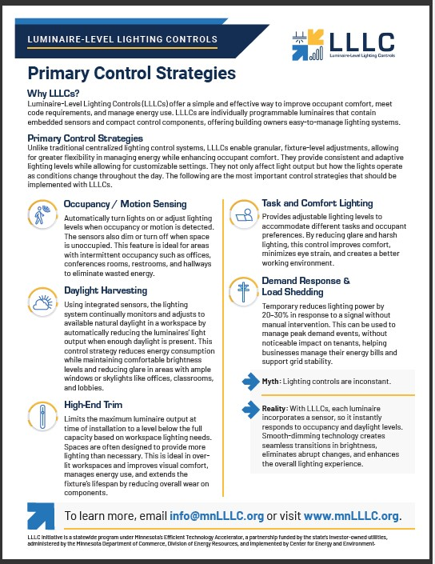
Results to Date 2025
Outreach Activities
  Shifted focus to existing building market
  Focused on Mfg. Rep agencies
Demonstration sites/case studies
  4 additional pilots in the works
  2 case studies
National collaboration
  NEEA, Ameren IL, DLC
Launched our initiative website spotlighting tools, resources, and events
www.mnLLLC.org

Slide 17
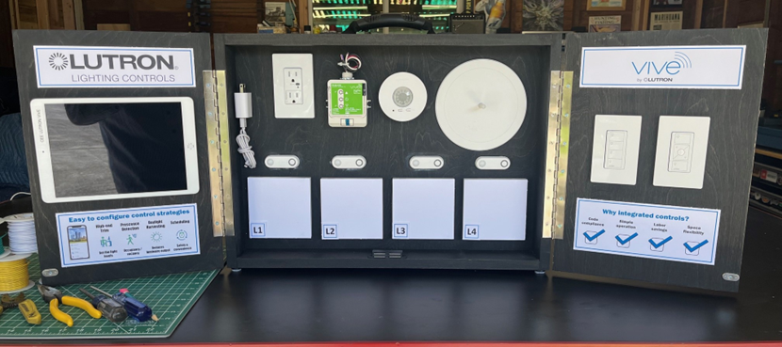
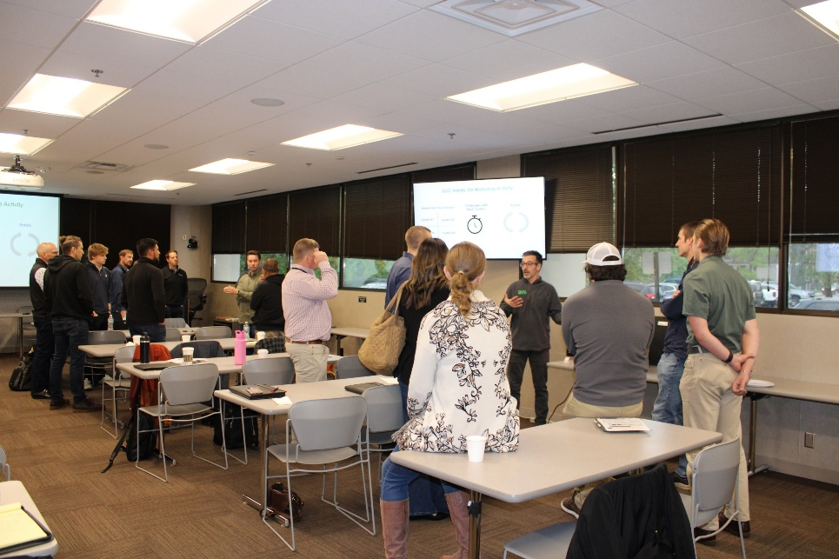
Results to Date 2025
Built 6 LLLC demonstration boards for engaging Mfg. Reps and training the market
Held 3 hands-on LLLC workshops, and have 2 more coming up in early December
  Program champion events
  Utiltiy partnerships
Launched NXT level Training
Completed market mapping and designer research

Slide 18
LLLC Initiative – Looking Ahead
Strengthen utility partnerships
  Incentive alignment
  Engage with account managers
Outreach efforts
  Focus on existing building market
  Distributors, contractors, and building owners/managers
Training
  Demonstration workshops
  Customer/designer cohorts
  Webinar series
Research LLLCs and HVAC integration
Research demand response and load shedding

Slide 19
Lessons Learned & Challenges
Lessons Learned
Leverage what already exists and works in the market
Demonstration boards have been well received
The market is evolving - “standalone” controls and Tier 2 mfg are driving the market
The bulk of LLLC installs are happening in the retrofit market in MN, and a small number of key Mfg. Reps represent the bulk of the equipment being installed
Challenges
Lack of awareness with end users and contractors
Overcoming the TLED mindset
Lack of consistency with LLLC terminology
Utiltiy incentives are underutilized, and the process is confusing
Finding the right person and getting their attention

Slide 20
Ed McGlynn
emcglynn@mncee.org

Slide 21
Chris Wolgamott
Efficiency Alliance (NEEA)

Slide 22
Demonstrating Interoperability and HVAC Integration:
Chris Wolgamott
Principal Product Manager

Slide 23
Today’s Agenda
Looking at the what and the why of the demonstration project
The Why
  Background of demonstration project
  Objectives
The What
  Project details
  Early outcomes

Slide 24
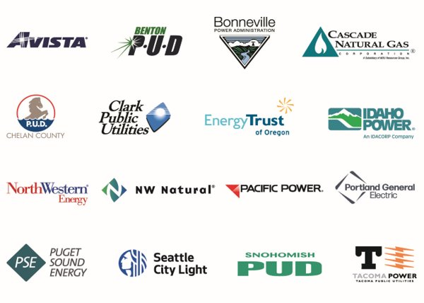

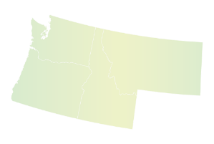
Who is NEEA

Slide 25

The Low Hanging Fruit is gone!

Slide 26
What is LLLC?
NLC
LLLC
A networked lighting control system consists of an intelligent network of individually addressable luminaires and control devices, allowing for application of multiple control strategies, programmability, building- or enterprise-level control, zoning and rezoning using software, and measuring and monitoring.
Luminaire Level Lighting Control, in which each luminaire has a networked occupancy sensor and ambient light sensor installed and directly integrated or embedded into the luminaire form factor during the manufacturing process or installed in the field.
Design Lights Consortium - Definitions

Slide 27
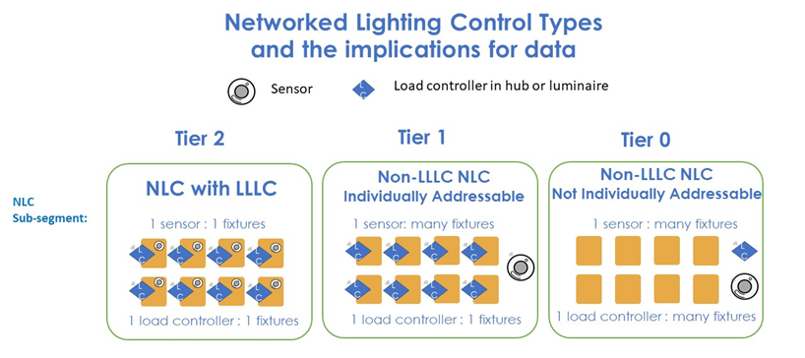
3 Tiers for Network Lighting Control Types

Slide 28
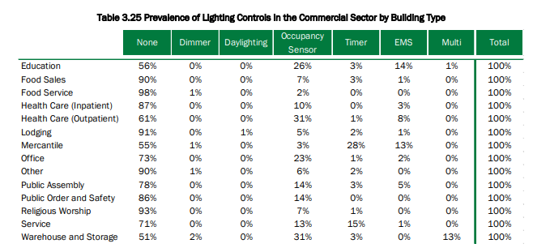
Lighting controls in Commercial Buildings
DOE 2020 US Lighting Market Characterization

Slide 29
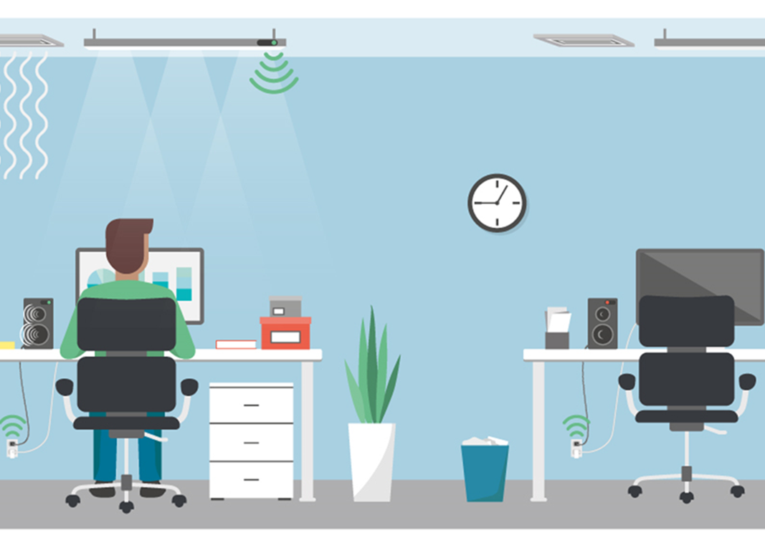
What is (Lighting) LLLC & HVAC Integration?
Occupancy sensors at a granular level (a sensor in every fixture)
LLLC provides a source of power for the occupancy sensors
Occupancy signal from lighting can be shared with multiple other building systems, including the HVAC system
Lighting provides a visual indication the sensor is functioning
5-25% energy savings from the mechanical system on top of the 50-65% energy saving from the lighting

Slide 30
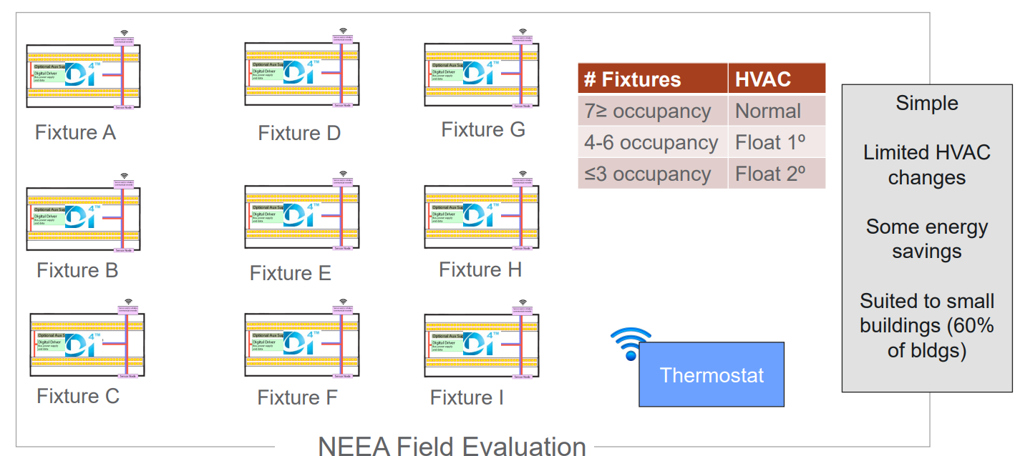
NEEA Field Evaluation
Image courtesy of PNNL

Slide 31
NEEA 2024 LLLC/HVAC Integration Project
Lighting System Retrofit (88) 3 lamp F32T8 fluorescent parabolic fixtures were renewed with a custom LED retrofit kit that included a certified DALI D4i driver, and an integral D4i and Zhaga Book 20 compatible sensor/controller.
HVAC Thermostat Retrofit (5) Older programmable thermostats were replaced with state-of-the-art BACnet and Modbus enabled Wi-Fi thermostats.
Gateway An edge gateway was installed to facilitate local communication with the Wi-Fi thermostats over Modbus TCP, communicate with the Bluetooth Mesh NLC lighting sensors/controllers, and host the evolving LLLC/HVAC setback logic.
Energy Metering System A commercial grade energy meter/datalogger/web server was installed to measure and log real-time RTU energy usage and support M&V data collection.
Launched in September 2024, the goal of the project is to measure how occupancy data from an integral fixture sensor can inform and optimize HVAC system operation in a typical small/medium commercial building. The field demonstration was deployed in a 12,500 sqft office in Northern California consisting of private offices, conference rooms, open plan, reception and employee lunch/breakroom. The area is served by five thermostatically controlled, single zone, constant volume rooftop HVAC units.

Slide 32
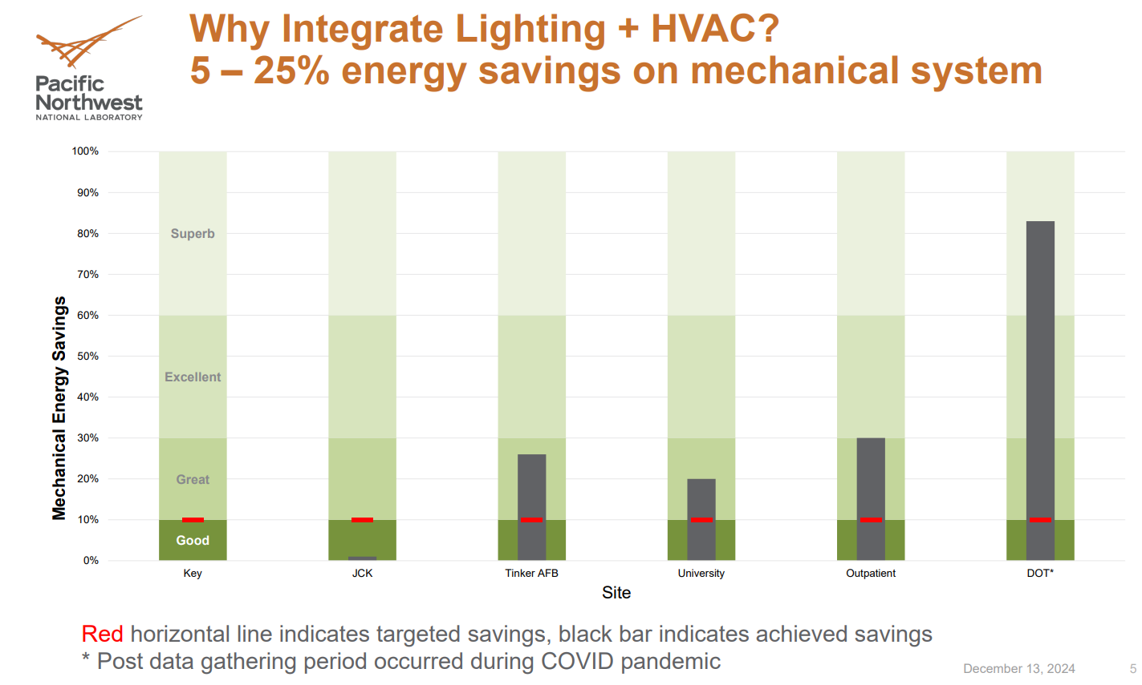

Slide 33
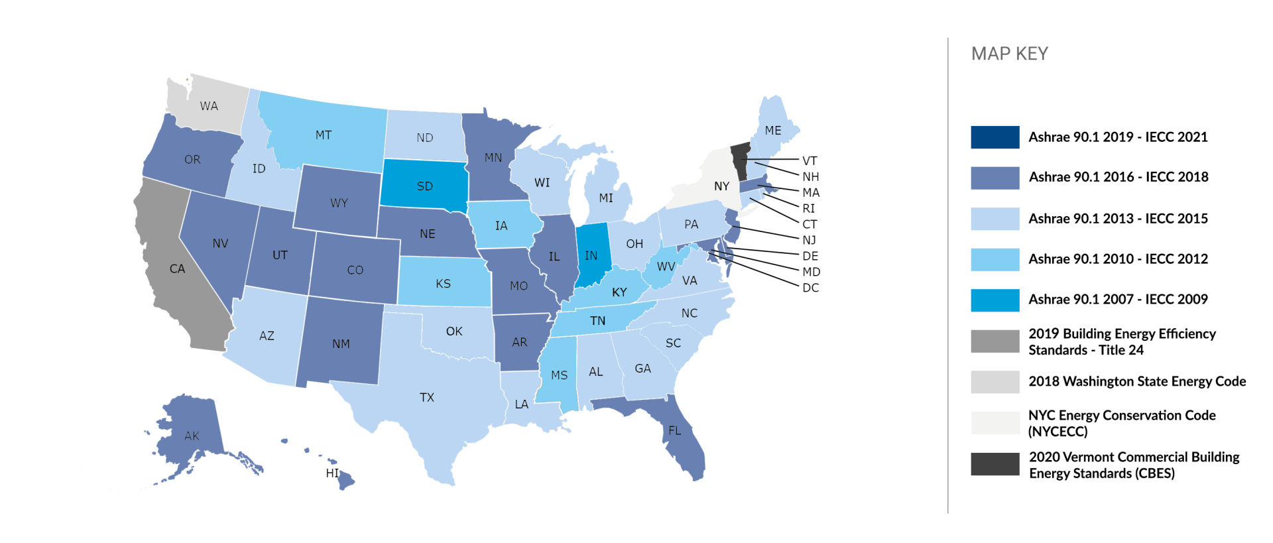
Energy Codes are primary drivers for Integration
…and getting more stringent
Occupancy Sensors (Lighting & HVAC)
Occupied Standby (HVAC)
Plug Load Controls
Demand Response
Source: www.cove.tools (2021)

Slide 34
The average commercial building consumes 52% of its energy operating the heating, cooling and ventilation systems.
Major fuels consumption
by end use (2018)
Source: U.S. Energy Information Administration, Commercial Buildings Energy Consumption Survey; Note: Btu = British Thermal Units

Slide 35
RTUs are a big opportunity for commercial energy savings
60%
Conditioned by RTU
1/5
Consumed by RTU
70-90%
Gas-fired RTU
And key energy saving strategies for RTUs are being overlooked

Slide 36

The Changing world of Utility Incentives
LED Fixture incentives shrinking or disappearing
Control Incentives still available
Systems becoming more valuable than Widgets
HVAC energy savings much greater than lighting incentives
Flex Load (Demand Response) becoming very important

Slide 37
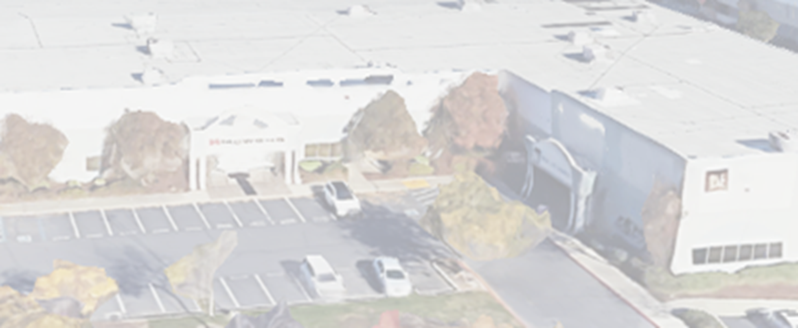
What is the Project?
Retrofit a medium-sized commercial space with LED lighting, advanced mesh-based controls and HVAC integration
Location: Sacramento California

Slide 38
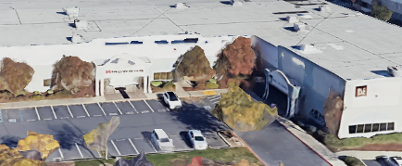
What is the Project?
Physical characteristics:
  Mid-size commercial facility (25,000 ft²)
              10,000 ft² of offices, conference rooms, lunch/break room
                15,000 ft² of warehouse and production space
  Building vintage: 2001
Project duration:
  Installation and commissioning Q3 2024
  Data Gathering began late Q4 2024

Slide 39

Project Lighting and HVAC Characteristics
Variety of light sources
    Fluorescent, LED, CFL, halogen, and incandescent lighting
Variety of lighting controls
    Stand-alone occupancy sensors and switches
    Small mesh networks
Original HVAC system
    Five rooftop units (RTU)
    Hardwired thermostats

Slide 40
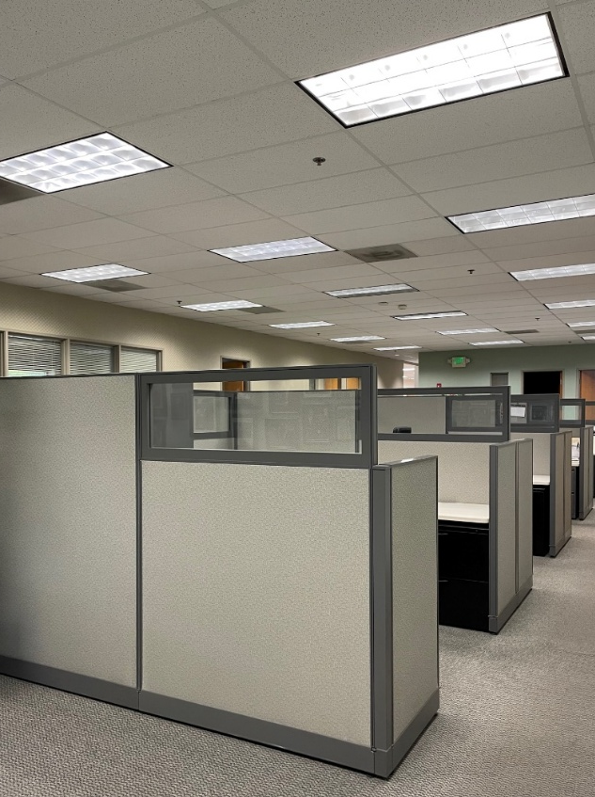
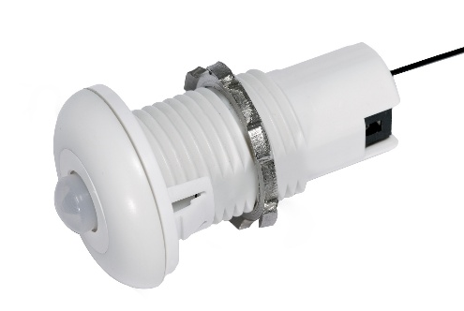
Retrofit Project Details: LLLC with Open Standards
Space types:
  Executive private offices
  Accounting, administration, sales private offices
  Lunch/break room
  Open office area with cubicles
  Conference rooms
Control Network:
88 LED luminaires with:
    DALI D4i driver
    Embedded Bluetooth NLC-qualified/DALI D4i/Zhaga Book 20-compliant
    sensor-controller for LLLC
    Wireless kinetic wall switches in some spaces, 4-button wall controllers in other spaces

Slide 41
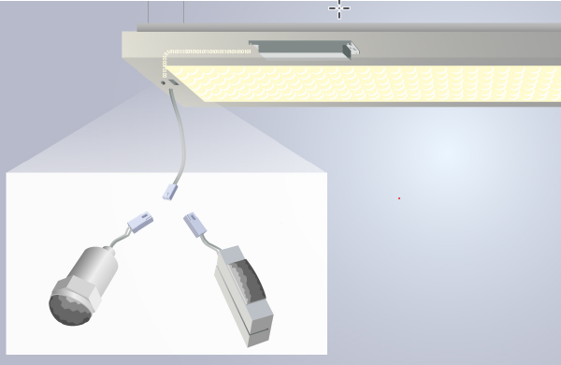
LLLC and Open Standards
Mechanical Interoperability: Zhaga Book 20
Standardized way for the control module to fit within the luminaire
    Smart interface between an indoor LED luminaire and a sensing/communication module
    Sensing/communication module connects to LED driver, and typically provides sensory inputs or enables communication between network components
Project team can utilize different control modules across a single project if desired, with a “plug and play” capability
Streamlines LLLC installation
    Control device can be installed into the fixture at the manufacturer so luminaire can be installed at the project as a complete unit
Image courtesy of Zhaga Consortium

Slide 42
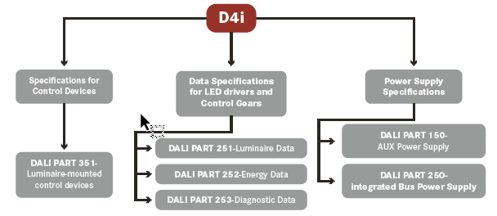
LLLC and Open Standards
Intra-luminaire Interoperability: DALI D4i
Open standard communication interface between the components within a luminaire
    drivers and embedded control devices
  DALI D4i standard, an extension of DALI-2, establishes specific criteria for data and power transmission between devices inside the luminaire
  Enables data harvesting from components inside the luminaire
    Energy monitoring
    Occupancy monitoring

Slide 43
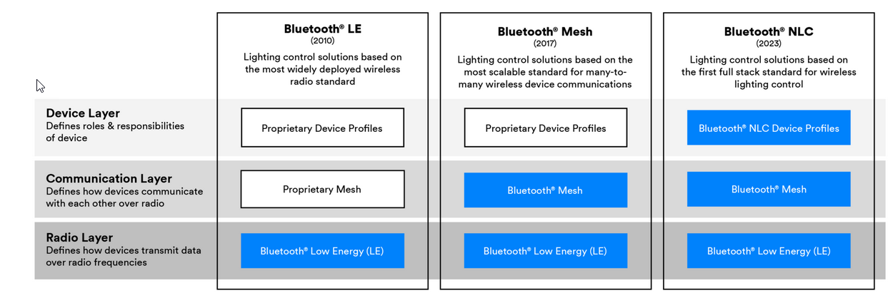
LLLC and Open Standards
Network Interoperability: Bluetooth NLC
Full-stack standard for wireless lighting control
Standardization from the radio through to the device layer
Image courtesy of Bluetooth Special Interest Group

Slide 44
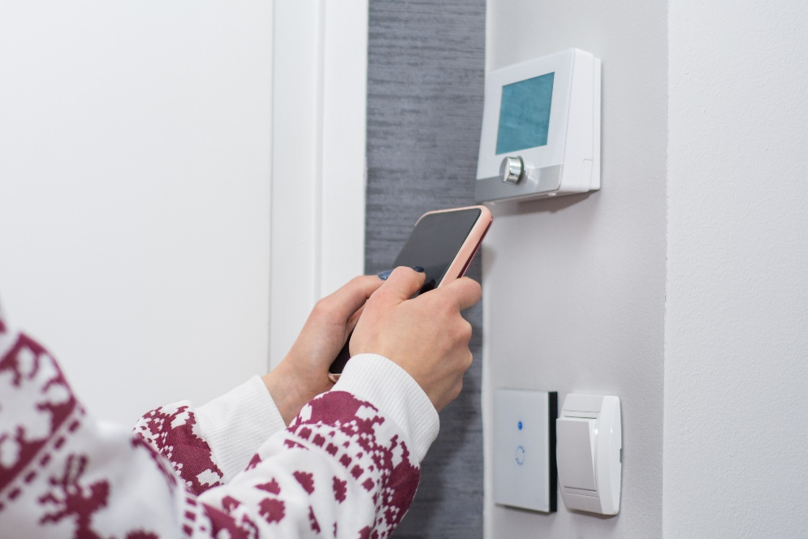
Retrofit Project Details: HVAC Integration
Hardwired thermostats replaced with wireless mesh enabled models and connected to edge gateway
Created 5 HVAC zones
    RTU #1: Accounting, Administration, Sales, Open Plan East, Open Plan West, OPEE, PC, Library
    RTU #2: Executive #1, Executive #2, Executive #3, Conference room
    RTU #3 Kitchen, Dining, Lounge, Restrooms
    RTU #4 & 5 not participating in demonstration

Slide 45
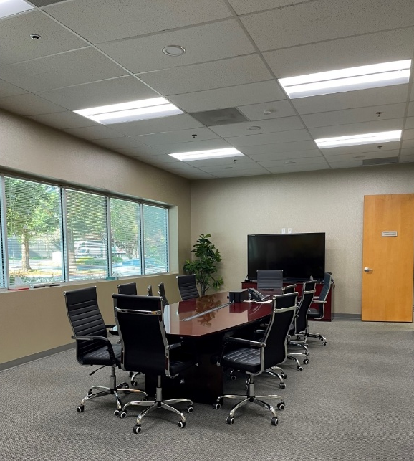
LLLC Control Highlights
Private offices, break room, foyer, and open floor plan areas
Control strategies
  High end trim (70% output)
  Dimming level of 55% when occupied
  Perimeter space with large windows and daylight contribution:
        Zones with daylighting + occupancy
        Zones with occupancy
Circadian profile for conference room
    Occupancy sensing + daylighting
    2400K CCT at 6 am, transitions to 6000K CCT through mid-afternoon, then transitions back to 2400K by 8 PM and automatic shutoff
Tunable white for spaces without windows

Slide 46
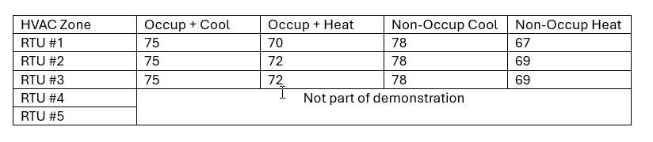
HVAC Integration Highlights
Legacy “Set Point” approach (weekday and weekend settings only) updated to capture data from occupancy sensors
    “Cascade” set point program
    “Occupied/Business hours” and “Occupied/ Non-business hours” spectrum

Slide 47
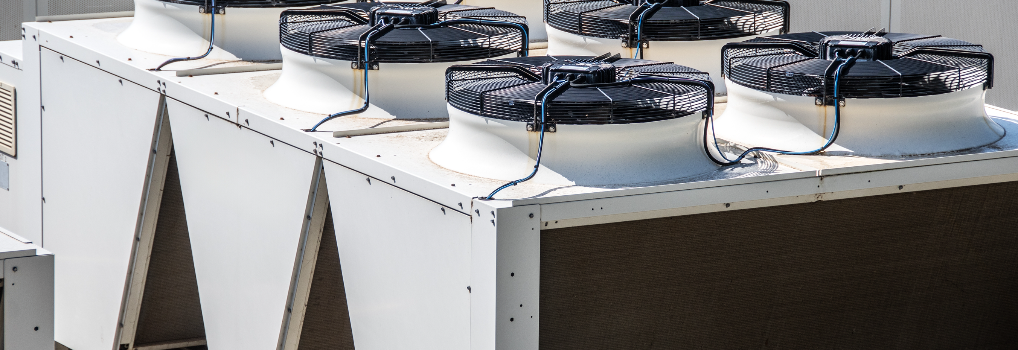
Project Implementation Challenges & Early Learnings
Multiple wireless communication protocols
Thermostat installation: Initial power requirement issues; hidden default settings
Sufficient Wi-Fi to facilitate Modbus communication between edge device and thermostats
Programming challenges associated with edge device integration algorithms
Hardware/software challenges with capture of multiple data streams

Slide 48
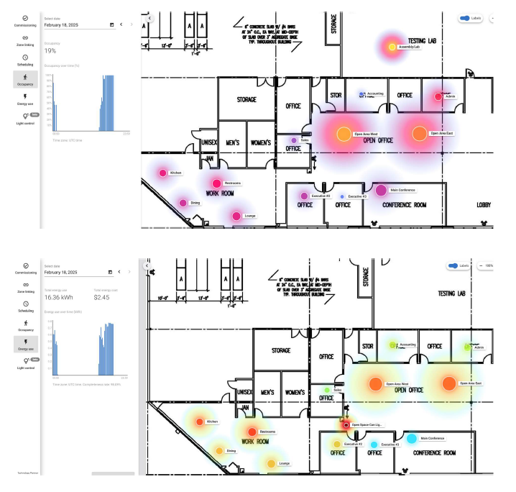
Early Project Outcomes
LLLC Aspect:
69% reduction in energy consumption from lighting and controls retrofit
HVAC performance:
  Winter project start means less electricity (cooling) savings
  Holidays = more variable occupancy data
  Increased vacancy = thermostat setpoint adjustments
  Preliminary projected results = 5-10% energy savings (gas and electricity)
Report is due out in late 2025

Slide 50
Next Steps
Notes:
Thank you to Ed and Chris for sharing the details about their programs. That’s a lot of great information!
We will be sharing a copy of these slides for your reference.

Slide 51

Next Steps
PPWG Meeting Schedule
✓ | Kickoff & Topic Planning | Mar 6
✓ | NLC Implementation | Apr 24
✓ | NLC/LLLC Market Engagement | Jun 26
✓ | LED Saturation | Jul 22
✓ | Reaching Small Businesses | Sep 4
→ | LLLC Implementation | Oct 30
 | Annual Review & Recap | Dec 11
Notes:
We have just one meeting remaining on our schedule for the 2025 PPWG.
On December 11th we’ll be recapping the year, including a summary of all the topics.
We’ll also be packaging up all the resources and tools available to you, several of which were discussed in PPWG meetings.
Finally, we’ll be discussing what the PPWG might look like next year. Your input will be important!

