Slide 1
Follow-Up Clarification: Energy Savings from Networked Lighting Control (NLC) Systems With and Without LLLC Capabilities
Date
02/26/2025
Notes:
Bagwat to start

Slide 2
Speakers
Bagwat Mohan
DLC
Yao-Jung Wen, PhD, LC
Energy Solutions
Chris Wolgamott CEM, CDSM
NEEA

Slide 3
Agenda
Introduction
Key clarification points
Wrap up
Q&A

Slide 4
Webinar Logistics
All attendees on mute
Ask questions as we go using Question feature of webinar
If you experience any technical issues, use Chat feature to let us know
Presentation and recorded webinar will be posted to the DLC website

Slide 5
Introduction
Notes:
Chris to take over from here

Slide 6
The 2020 Report Energy Savings from Networked Lighting Control (NLC) Systems With and Without LLLC
Quantified the NLC savings potential
49% overall
63% for NLCs with LLLC
35% for NLCs without LLLC
Based on large and diverse data sets
194 data sets (i.e., buildings, NLC installations)
98 data sets for NLCs w/ LLLC
96 data sets for NLCs w/o LLLC
12 NLC manufacturers
7 building types
Across many states/provinces in North America
Notes:
The original report was published in September 2020.
We will use “the 2020 report” as a short-hand for the rest of the presentation.
One of the primary objectives was to derive the control savings factors for NLCs through a large data set so that prescriptive energy efficiency programs can reference for claiming savings.

Slide 7
TRM and EE Program Influence Since Publication
Cited by energy efficiency (EE) programs and technical reference manuals (TRMs) or equivalents in 21 states and provinces across the United States and Canada

Slide 8
The Memo
Addresses challenges in interpreting or applying the information in the report
Clarify ambiguous descriptions
More prominently highlight key points and messages
Updated executive summary for the original report
Errata
No new information was derived from the original data sets
Notes:
The memo also included an updated executive summary for the original report as well as a list of errata.

Slide 9
The Methodology
Identify existing confusion and issues through stakeholder interview
Targeted stakeholders
Program administrators/implementers
Program evaluators
Technical reference manual developers/advisors
Utility energy savings potential study consultants
Analyze stakeholder feedback and synthesize clarifications into digestible insights in the memo

Slide 10
Clarifications
Notes:
Yao-Jung to take over from here

Slide 11
Key Clarification Points
Definition of luminaire-level lighting controls (LLLC)
The effect of NLC system programming and optimization on control savings factors (CSFs)
Confirming CSFs with a smaller sample data set
Interpretation of CSFs broken down by control strategies
Interpretation of CSFs broken down by building types
Relation between the 2020 Savings Report and other related studies
We will use a Q&A style to clarify these key points

Slide 12
Question 1:
What types of LLLC are the CSFs applicable to?

Slide 13
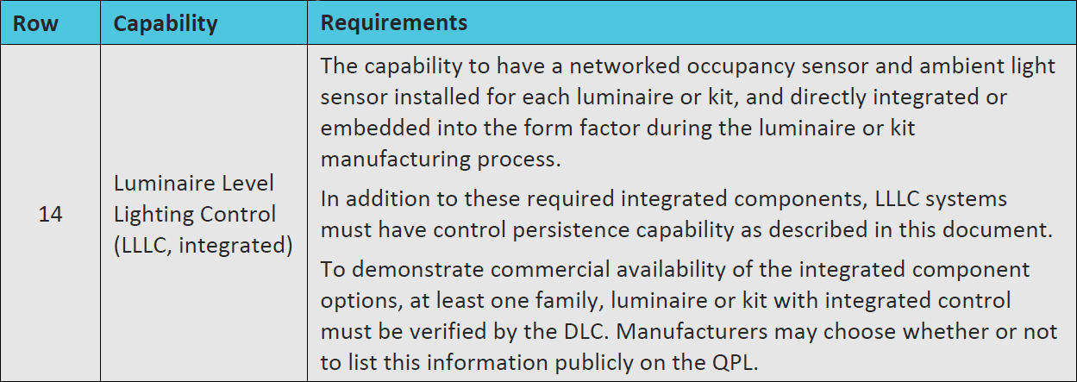
NLCs w/ LLLC in the data sets were differentiated based on
Definition in the DLC NLC Technical Requirements
System listed on the DLC NLC QPL
The overall average CSFs are most applicable to systems meeting the above criteria
The CSFs broken down by control strategies may apply to other types of integrated sensors/controls (more on this later)

Slide 14
Question 2:
To what extent must the NLC systems be programmed and commissioned so the CSFs can be applied to a prescriptive program?

Slide 15
CSFs represent savings averaged across NLCs with various degrees of programming
All systems included in the study were programmed to be functioning, but no insights into every individual system as to:
Which control strategies were activated/enabled
How the control parameters were set/optimized for energy savings
➔ CSFs do not represent the maximum achievable saving potential!
This mix would likely best represent the full spectrum of system programming for NLCs incentivized through prescriptive EE programs

Slide 17
Question 3:
Why would the savings be significantly higher or lower than the reported CSFs when energy savings are quantified from a sample set of a program’s project portfolio through an M&V effort?

Slide 18
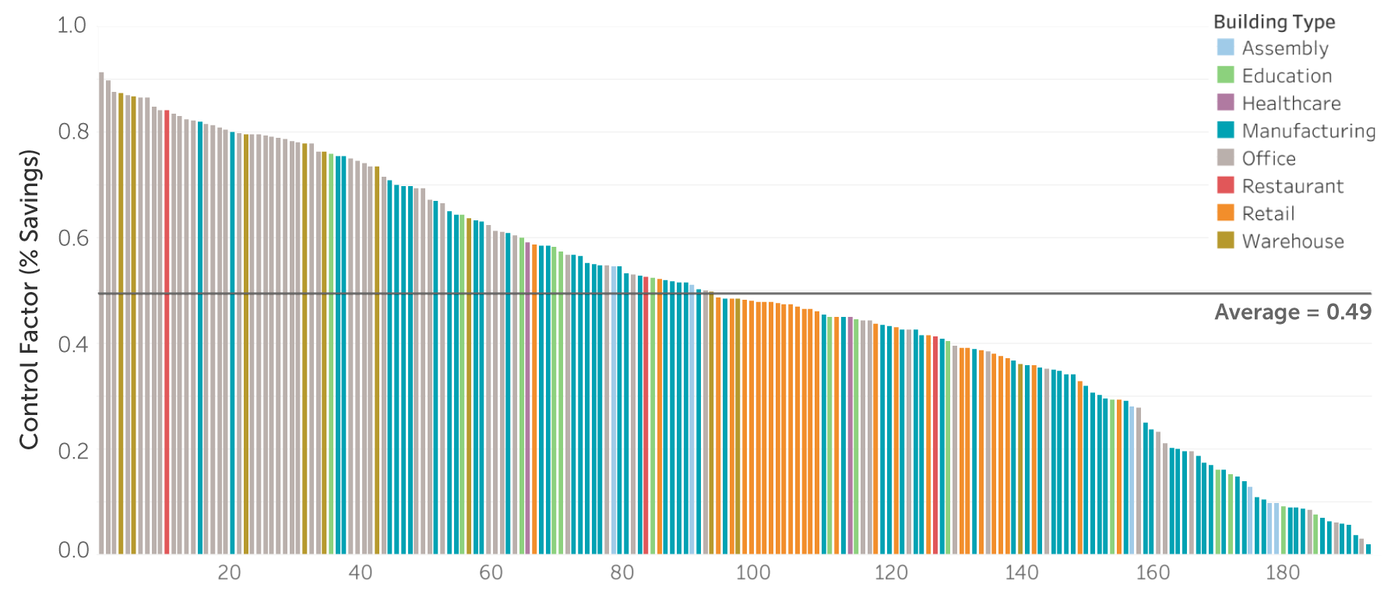
The CSFs were derived from a meaningfully large and diverse data set
Need to be mindful of the potential biases extreme cases may introduce when the sample pool is small

Slide 19
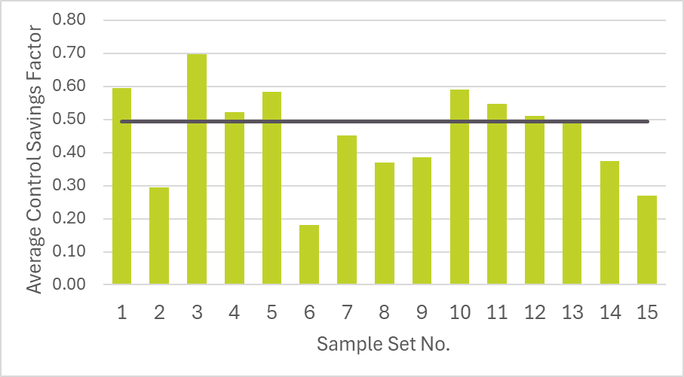
Simple exercise: What would the average savings look like if we randomly sample 5 from the 194 data sets included in the study?
Do this exercise 15 times, and the results vary widely.
Many are nowhere near the 49% average.

Slide 20
Question 4:
Why aren’t the CSFs broken down by control strategies in the report adding up to the overall average CSFs?

Slide 21
The report provided CSFs broken down into savings contributed by “high-end trim” and “other control strategies”
“Other control strategies” CSFs represent combined savings from occupancy sensing and daylight harvesting
Savings contributed by high-end trim
Max luminaire output
Highest output
observed
Savings by other control strategies
“Occupied” threshold
defined as 10% of max measured power
Sample zone within a building
Notes:
Explain how the control factors for other controls are calculated

Slide 22
The report provided CSFs broken down into savings contributed by “high-end trim” and “other control strategies”
“Other control strategies” CSFs represent combined savings from occupancy sensing and daylight harvesting
0.37+0.41≠0.63!!
LLLC Presence | Total Buildings | Control Factor (% Savings)
 |  | Average | 25th–75th Percentile | High-End Trim Contributions | Other Control Strategies*
NLCs w/ LLLC | 98 | 0.63 | 0.50 - 0.79 | 0.37 | 0.41
NLCs w/o LLLC | 96 | 0.35 | 0.17 - 0.48 | 0.17 | 0.22
All NLCs | 194 | 0.49 | 0.35 - 0.69 | 0.27 | 0.32
Note: The numbers provided in this table is meant to provide a high-level overview of average savings trends. Additional study is needed to control for potentially confounding variables, and thus at this time does not imply that LLLC is universally superior and applicable to all building types. *In this report, the control factors for control strategies other than high-end trim, unless otherwise noted, are in comparison to an inferred baseline with savings from high-end trim removed. Therefore, the control factors for high-end trim and other control strategies will not add up to the overall control factor. See Page 33 for a more detailed discussion.

Slide 23
The broken-down CSFs are derived to represent the two types of savings independent of each other
They can be applied separately by programs if so desired
E.g., high-end trim CSFs may be applied to luminaires that have embedded control nodes but no sensors
E.g., “other control strategies” CSFs may be applied to luminaires with integral occ and photosensors but with no/limited networking capability (also known as dual sensor, multifunction sensor, combo sensor, etc.)

Slide 24
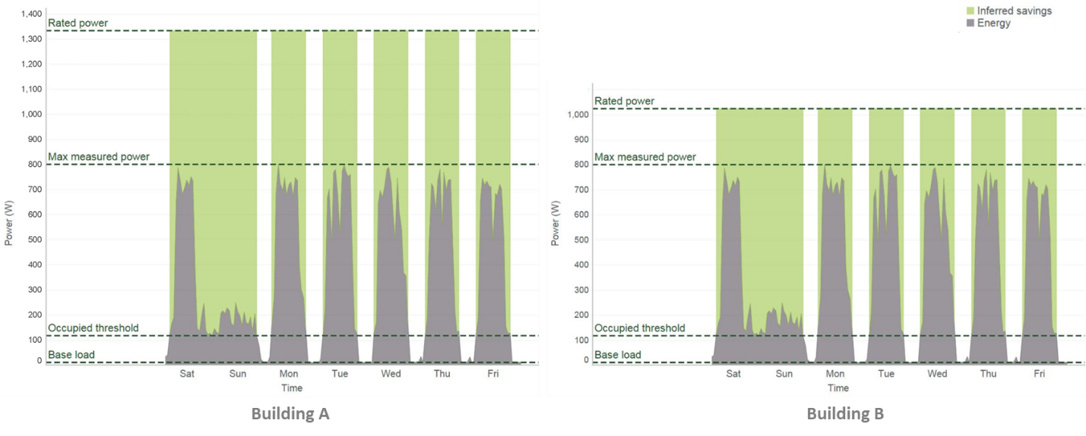
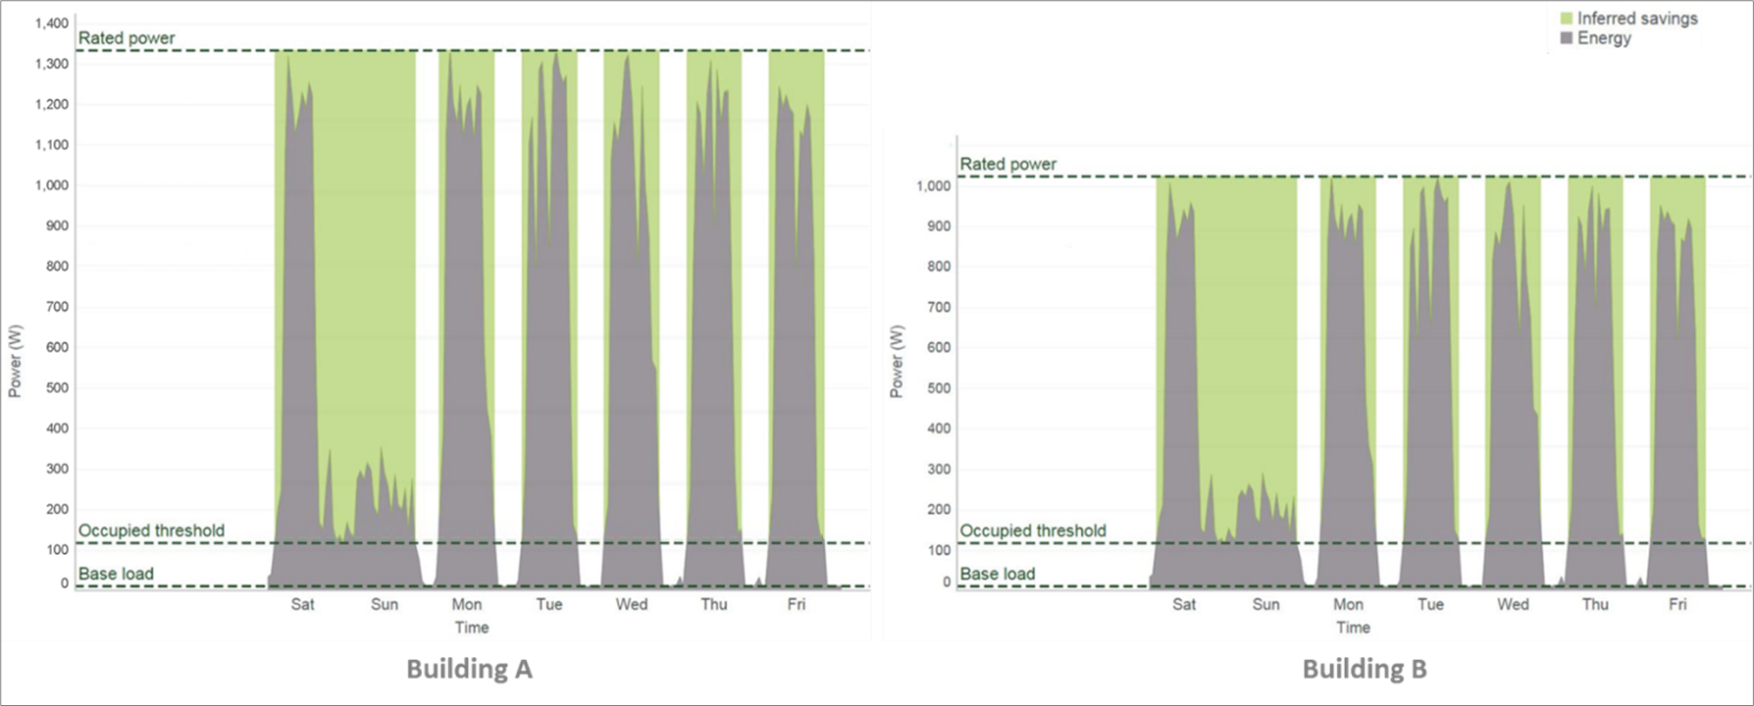
“Other control strategies” in the two cases save the same amount of energy, but CSFs would be different percentage-wise depending on how much the lights are trimmed
The original “other control strategies” CSFs presentation removed the high-end trim dependencies
Notes:
Note: This slide contains multiple charts overlapping with each other. They will show up correctly as animation in Slideshow mode.
If we need to produce a PDF version for distribution, we need to split this slide into two slides, each containing a static image.

Slide 25
The report did provide broken-down CSFs that add up to the overall average in the later section.
Fixed relationship between the two “other control strategies” CSF presentations (in the errata page)
LLLC Presence | Total Buildings | Control Factor (% Savings)
 |  | Average | High-End Trim Contributions | Other Control Strategies Savings as a Fraction of the Full Rated Load when High-end Trim is Enabled¹ | Other Control Strategies Savings Regardless of Whether High-end Trim is Enabled²
NLCs w/ LLLC | 98 | 0.63 | 0.37 | 0.26 | 0.41
NLCs w/o LLLC | 96 | 0.35 | 0.17 | 0.18 | 0.22
All NLCs | 194 | 0.49 | 0.27 | 0.22 | 0.32
1. Control factors were calculated with respect to the inferred baseline. 2. Control factors were calculated with respect to a baseline where influence and savings from high-end trim were removed. Note: The numbers provided in this table is meant to provide a high-level overview of average savings trends. Additional study is needed to control for potentially confounding variables, and thus at this time does not imply that LLLC is universally superior and applicable to all building types.

Slide 26
Question 5:
What do the CSFs represent when broken down by building types?

Slide 27
The report provided CSFs broken down into different building types
Building Type | Total Buildings | Unique Manufacturers | Control Factor (% Savings)
 |  |  | Average | 25th–75th Percentile | High-End Trim Contributions | Other Control Strategies
Assembly | 6 | 2 | 0.28 | 0.11 - 0.45 | 0.07 | 0.23
Education | 14 | 5 | 0.41 | 0.19 - 0.58 | 0.19 | 0.32
Healthcare | 2 | 1 | 0.52 | 0.48 - 0.56 | 0.33 | 0.24
Manufacturing | 73 | 4 | 0.40 | 0.20 - 0.55 | 0.16 | 0.29
Office | 57 | 8 | 0.64 | 0.53 - 0.81 | 0.46 | 0.36
Restaurant | 3 | 2 | 0.59 | 0.47 - 0.68 | 0.27 | 0.30
Retail | 29 | 1 | 0.44 | 0.39 - 0.48 | 0.22 | 0.27
Warehouse | 10 | 2 | 0.68 | 0.53 - 0.79 | 0.38 | 0.48
Overall | 194 | 12 | 0.49 | 0.35 - 0.69 | 0.27 | 0.32
* A control factor is a number between 0 and 1, representing the fraction of the energy saved through controls. 0 represents no savings, and 1 means all energy is saved. Control factor is equivalent to percent savings (% savings) when presented in percentage. For example, a control factor of 0.49 is equivalent to 49 percent savings (49% savings). ** The range for the middle 50% is displayed instead of the full range between the minimum and the maximum to provide a more representative range of savings one can generalize and expect.

Slide 28
The CSFs for each building type represent savings for the entire building
Including primary functional areas
Including all supporting spaces
Not to be confused with the common building energy modeling approach
A building is made up of functional spaces
Each functional space has its schedule for lighting, occupancy, HVAC, etc.
The CSFs per building type are not meant to be treated as “function area” CSFs and be further synthesized
Example: Light Industrial Manufacturing Building Model
Space Name | Function Area | % of Building
L_Break | Break | 0.025
L_Cordr | CorridorStairway | 0.050
L_LobWait | LobbyWaiting | 0.025
L_MechElec | MechElecRoom | 0.025
L_OffGen | OfficeGeneral | 0.100
L_Restrm | Restroom | 0.050
L_Sales | RetailSales | 0.050
WK_Stock | StockRoom | 0.050
WK_Work | Work | 0.625
Total |  | 1.000

Slide 29
Question 6:
Why does another 2020 NEEA report say that NLCs with and without LLLC have indistinguishable savings potential?
Notes:
Chris to take over from here

Slide 30
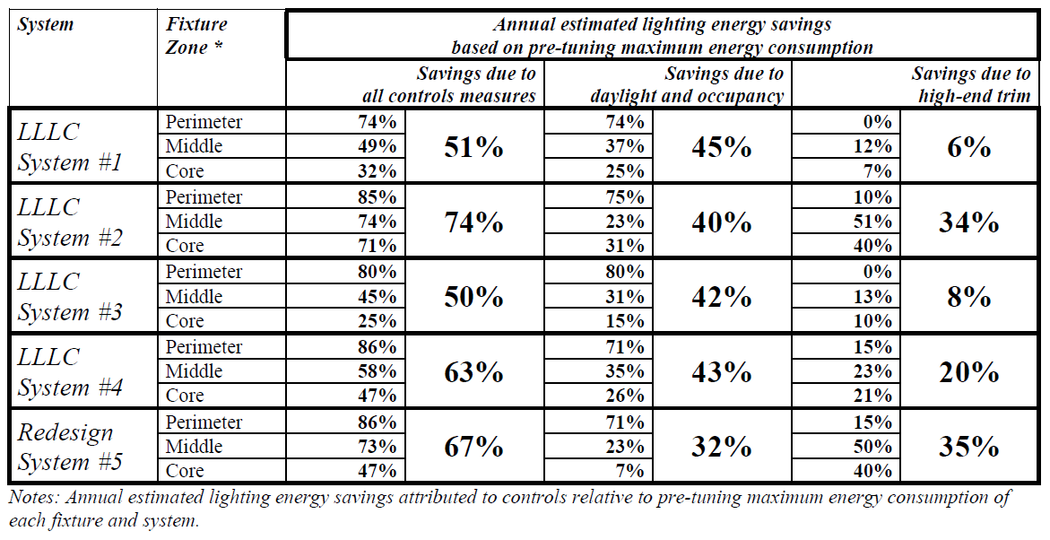
NEEA Report: “Luminaire Level Lighting Controls Replacement vs Redesign Comparison Study”
Published 15 days before this report
Concluded comparable savings between LLLC (50-74%) and NLCs without LLLC (67%)

Slide 31
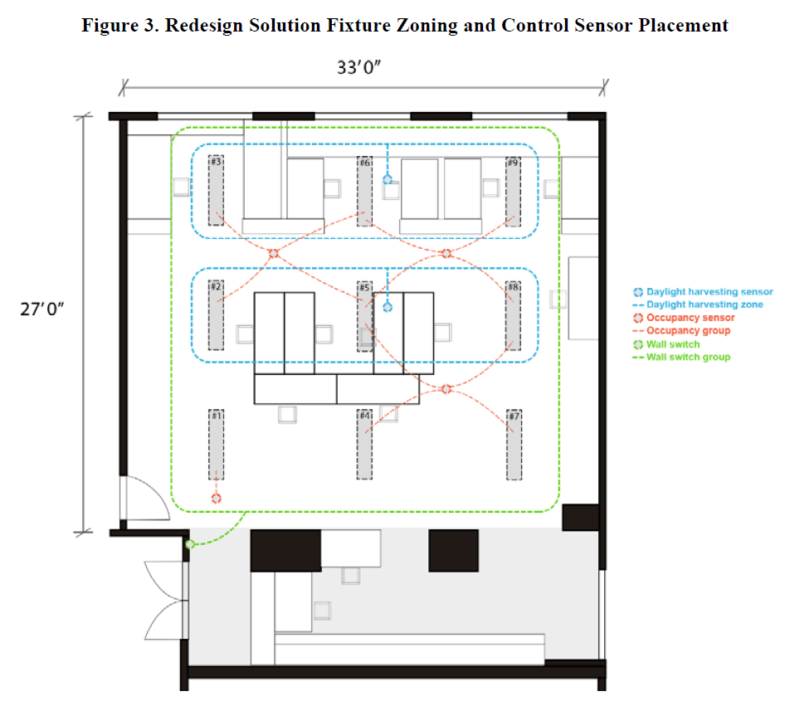
The Details
Compared five scenarios
4 LLLC systems for 1:1 replacement
1 comprehensive redesign solution using an NLC system without LLLC
Key message
LLLC as a 1:1 drop-in replacement solution can result in comparable energy savings as an NLC w/o LLLC with optimized luminaire layout, sensor placements, and system programming
The NLC w/o LLLC scenario in this case represents maximum achievable savings

Slide 32
The True Apples-to-Apples Comparison
2020 September 18 NEEA/DLC Report: Energy Savings from Networked Lighting Control Systems With and Without LLLC | 2020 September 3 NEEA Report: Luminaire Level Lighting Controls Replacement vs Redesign Comparison Study
63% average savings for LLLCs | 50-74% savings for LLLCs
35% average savings for NLCs w/o LLLC | 67% savings for NLC w/o LLLC with a comprehensive redesign approach
Savings estimated from NLCs spanning a broad spectrum of design efforts in lighting layout, sensor placements, and system programming | The NLC w/o LLLC scenario was optimized for energy savings in lighting layout, sensor placements, and system programming
The two reports really complement each other
NLCs without LLLC could achieve high savings when the system is carefully designed and optimized for savings
Utility custom programs could expect such high savings
Prescriptive programs are likely to see different levels of system programming and expect average savings level

Slide 33
Question 7:
How confident can the industry be with the CSFs, given the report recommending additional studies to further verify them?

Slide 34
The CSFs reported are supported by a meaningfully large and diverse set of measured energy data
The finding was not meant to discredit the CSFs but to encourage similar future endeavors to update control savings potential

Slide 35
Wrapping Up
Notes:
Bagwat to take over from here

Slide 36
Clarified seven key points that could have caused confusion in interpreting and applying the original report
More detailed clarifications are documented in the memo
Updated the executive summary of the original report to reflect these clarifications – also included in the memo
Issued errata – also included in the memo
Table 10. Summary of Estimated Control Factors By LLLC and Control Strategies.
LLLC Presence | Total Buildings | Control Factor (% Savings)
 |  | Average | High-End Trim Contributions | Other Control Strategies Savings as a Fraction of the Full Rated Load when High-end Trim is Enabled¹ | Other Control Strategies Savings Regardless of Whether High-end Trim is Enabled²
NLCs w/ LLLC | 98 | 0.63 | 0.37 | 0.37 0.26 | 0.41
NLCs w/o LLLC | 96 | 0.35 | 0.17 | 0.17 0.18 | 0.22
All NLCs | 194 | 0.49 | 0.27 | 0.27 0.22 | 0.32
1. Control factors were calculated with respect to the inferred baseline. 2. Control factors were calculated with respect to a baseline where influence and savings from high-end trim were removed.
Notes:
As part of this effort, we also updated the executive summary of the original report to reflect these clarifications.
The updated executive summary is included in the memo.
We also took the opportunity to issue a list of errata in the memo, which mainly includes corrections to the clerical errors in Table 10 of the original report.

Slide 37
Looking forward to seeing more prescriptive programs, both downstream and midstream, utilizing the report to offer NLC measures!

Slide 38
Key Takeaways for DLC Members & EE Programs

Slide 39
NLC Savings Vary Based on System Programming & Optimization:
Systems with better commissioning yield higher savings
Utilities should structure incentives (such as bonus) to encourage better system programming while applying CSFs from this report
Aligning EE Programs with TRMs and Incentives:
The memo helps refine TRM calculations
Provides clearer savings benchmarks to justify prescriptive incentives
Energy Efficiency Verification & Data Standardization:
CSFs should be applied carefully to avoid bias in small sample evaluations
Utilities should establish consistent M&V methodologies

Slide 40
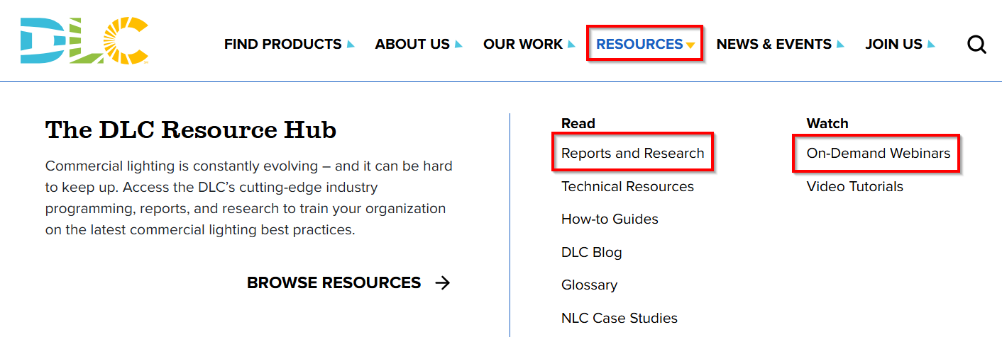
Report and Webinar Recording available
Full report and recording available on DLC website: https://designlights.org/resources/reports/report

Slide 41
Time for Questions

Slide 42
Thank You For Attending
Bagwat Mohan
Technical Operations Manager, DLC
bmohan@designlights.org
Chris Wolgamott CEM, CDSM
Sr. Product Manager, NEEA
CWolgamott@neea.org
Yao-Jung Wen, PhD, LC
Engineering Fellow, Energy Solutions
ywen@energy-solution.com
Levin Nock, PhD
Sr. Technical Manager, DLC lnock@designlights.org
Anne Curran
Sr. Program Manager, NEEA
acurran@neea.org

